Slide 1
Managing Consultants
A guide for working with consultants in government
Joe Owen
Jill Rutter

Slide 2
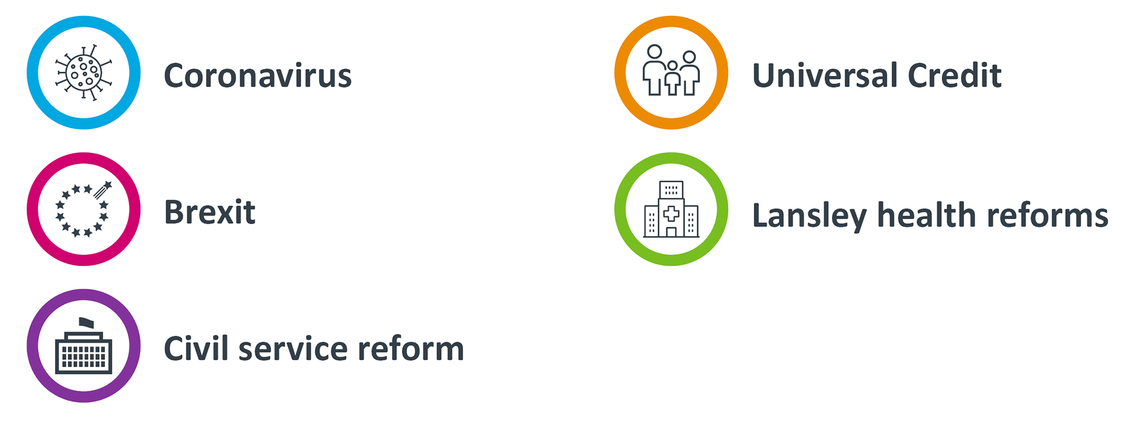
Consultants play an important role in government
Government’s use of consultants has waxed and waned over time. Under the coalition government, spend on consultants reduced dramatically – due to reforms driven by Francis Maude. But since 2016, spend has been
on rise.
Consultants have been involved in many of the most important issues in government in recent years.

Slide 3
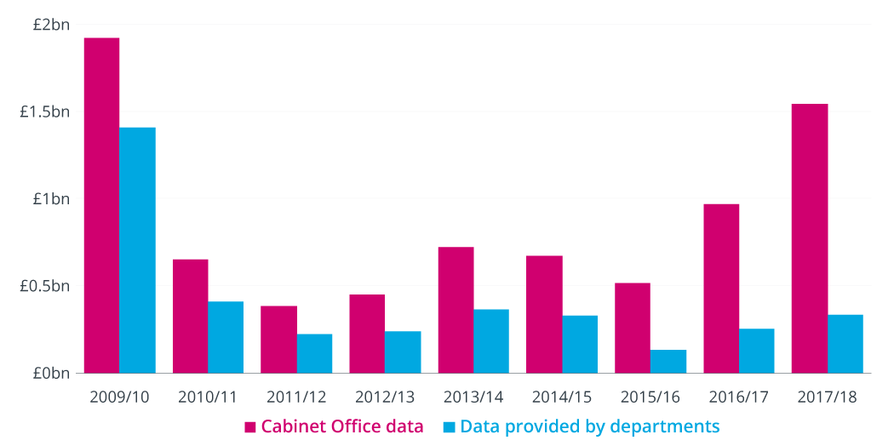
Figure 1: Government spending on consultants (£bn), 2009/10–2017/18
Source: Institute for Government analysis of National Audit Office data. Discrepancies between Cabinet Office and departmental data are due to departmental differences in classifying consultancy costs and inconsistencies in reporting between departments and years. The costs are measured in 2017/18 real terms using a GDP deflator.

Slide 4
There are controls and processes to manage spend
With many millions spent on consultants every year, the government has central controls on contracts with consultancy firms. The controls were introduced in 2010, but were refined in 2017/18. Any contract worth over £1 million requires central approval.
Cabinet Office
The Cabinet Office has Overarching responsibility for setting policy and controls on consultancy spend across government. Key day-to-day responsibility falls to the Government Commercial Function (GCF), part of the Cabinet Office.
Framework contracts
Government has put in place central ‘framework’ contracts. These contracts cover a small range of suppliers who have already successfully completed a process and been selected by government as capable of providing certain services.
If a department wants to buy those services, it can use the suppliers within the framework contract and avoid a full tendering exercise – with the aim of speeding the process up and getting value for money.
Government Commercial Function
If a contract requires central approval, GCF will assess it based on things like its length, value and rationale for requiring external support.
Crown Commercial Service
The Crown Commercial Service (CCS) helps government to buy goods and services, providing advice and ensuring government gets better value. CCS is a public body attached to the Cabinet Office. It is responsible for the key ‘framework contracts’.

Slide 5
Understanding the way consultancies work
As well as understanding the context in government, it is important to recognise how consultancies work – what their incentive structure is and, as a result, some of the things to expect when working with them. Consultants may work on many of the same projects as civil and public servants – in some instances they may be former colleagues – but it is important to remember:
Consultancies are private businesses that need to make a profit.
That profit depends on delivering work at a mark-up – and they have incentives to maximise that mark-up by reducing their costs where possible – and their biggest overhead is staff salaries.
Charge out rates, even for junior staff, can be very high in the leading consultancies – which is why any decision to use consultants needs scrutiny. They need to add real value to make it worthwhile.
Promotion in consultancies depends both on delivering results on the project in hand but also in building up a pipeline of projects.
The main task of the most senior people in consultancies – the partners – is to build up loyal clients and a steady flow of profitable business – their time is very expensive and they often do limited day-to-day work on projects (but good ones can add essential insights). Yours will just be one of a portfolio of projects they are engaged in.
Selling additional work to clients – once they are already on the ground and can identify potential areas of interest – is central to the business model. It can be a key reason behind pro-bono work. You can make this work to your advantage.

Slide 6
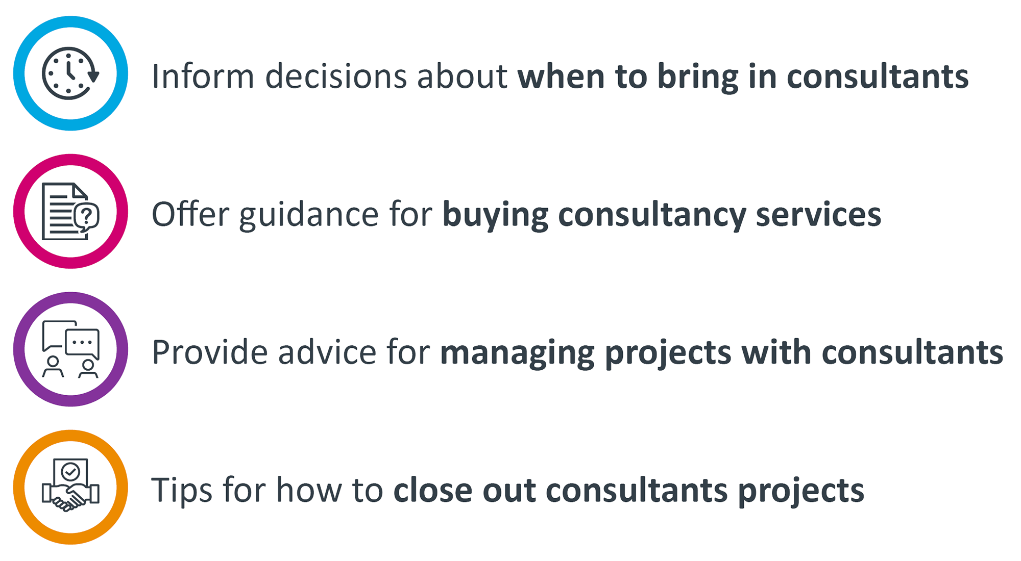
A guide to managing consultants
Within the many millions spent on consultants in government each year, there are often examples of poor value for money. In some instances, that will be due to the performance of the supplier, but in others it is a result of the management of projects by government.
This report draws on advice from current and former consultants and civil servants to provide practical tips for officials managing consultants in government. It does not pass judgment on how the government uses consultants, or whether or not it is a good or bad thing. It does not assess or analyse the approvals process.
This report aims to:

Slide 7
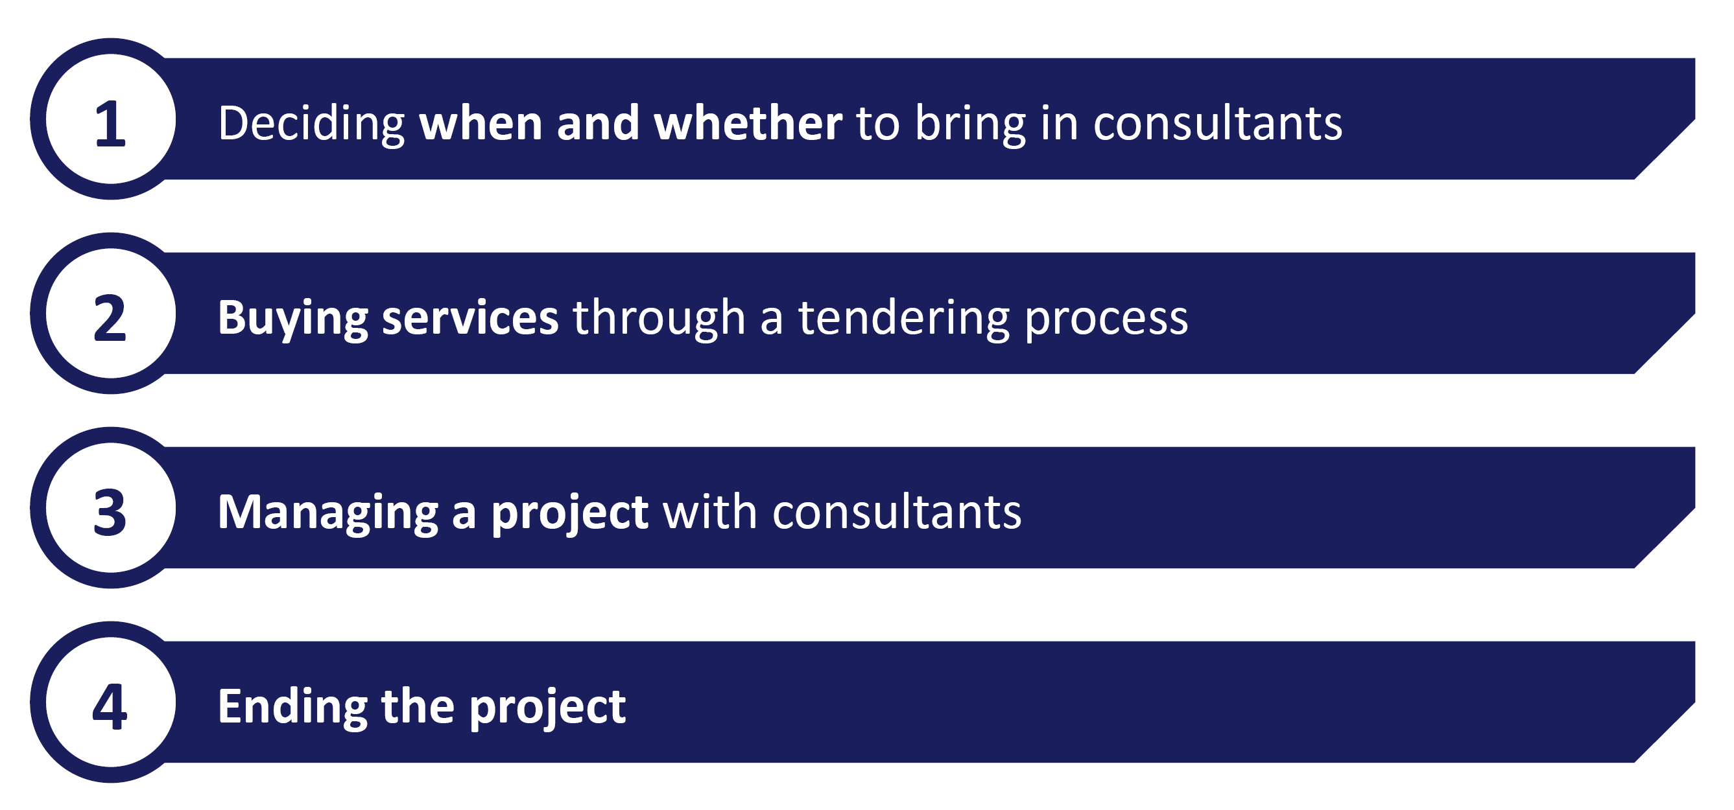
The structure of this report: four key phases
This report is structured around the four key phases of a government project with consultants. In each section we set out common pitfalls, key things to consider and practical advice based on our interviews with current and former consultants and officials.

Slide 8
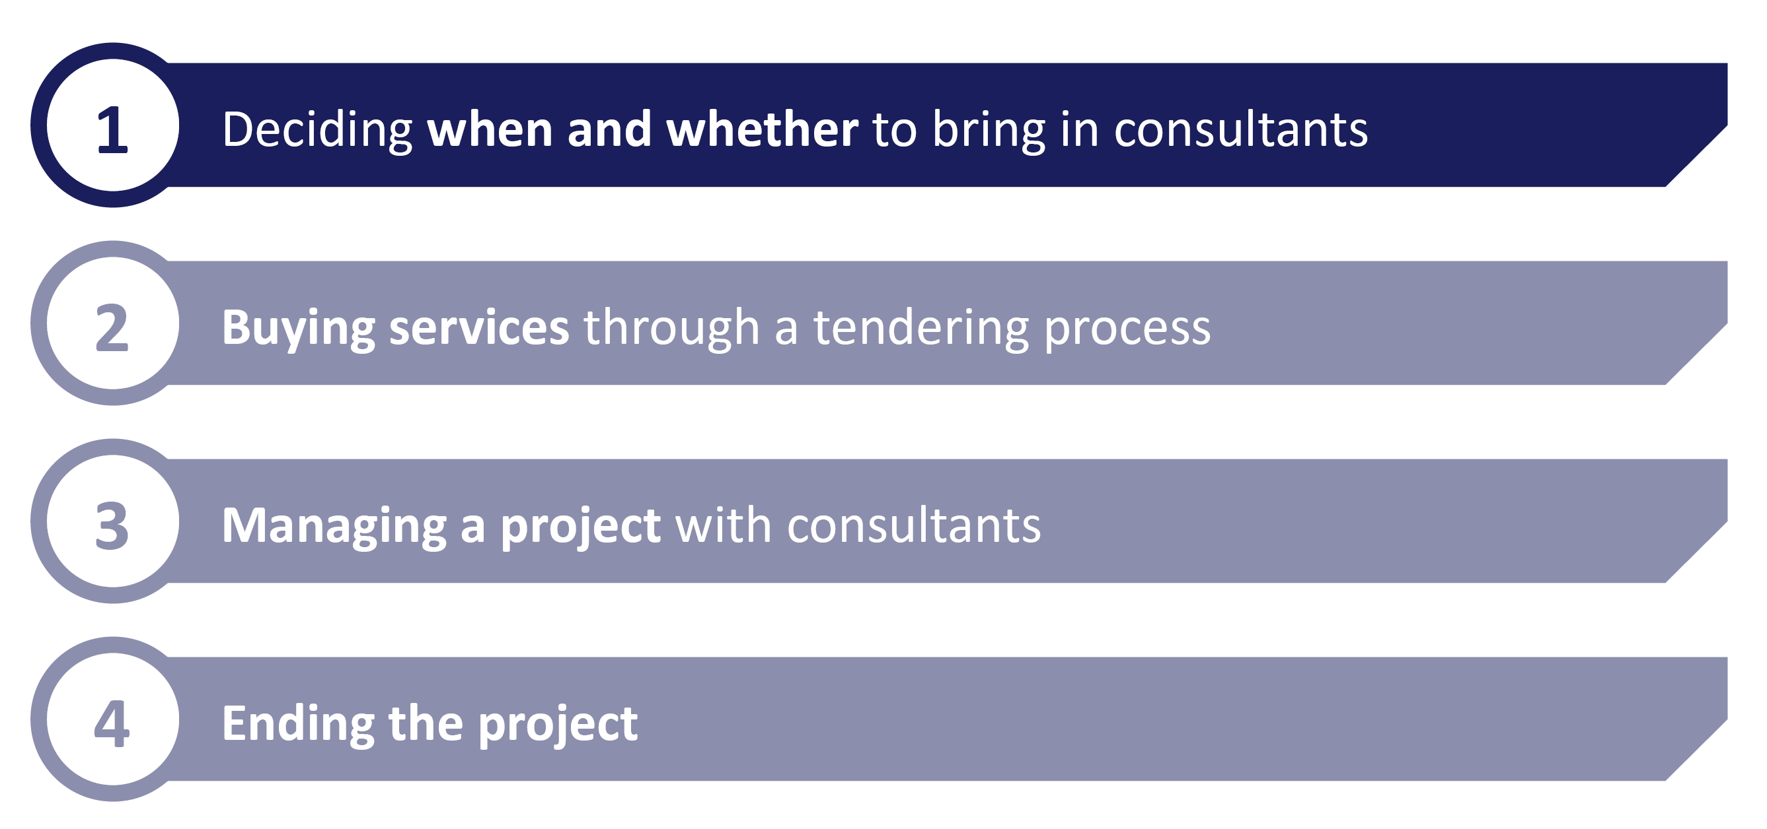
The structure of this report
This report is structured around four key phases of a government project with consultants. In each section we set out common pitfalls, key things to consider and practical advice based on our interviews with current and former consultants and officials.

Slide 9
There are good reasons to bring consultants in
There are many reasons why government seeks external support and, in turn, many different types of external support available – including commissioning academic research or bringing in senior experts to undertake independent reviews. A decision to bring in consultants is often made for one of three key reasons:
For skills
Government may want to bring in specialist experience in a given field – whether it is in a certain policy area or discipline such as programme management or technology delivery – because the skills required are not available on the timeframe or scale that is needed.
For capacity
In some instances government will need additional people to complete a specific task. Bringing in consultants allows government to quickly build up resources without worrying about an increase to headcount and fixed costs.
For a second opinion
Government may wish to bring an outside perspective to an issue. Consultants can provide independent verification of a decision, offer ministers another viewpoint or establish a set of options.
These are, in principle, legitimate reasons to bring in consultants – and often more than one will apply. But there are often other – less valid – reasons to bring in external support.

Slide 10
But there are bad reasons to seek external support
Consultants can, however, be brought in for the wrong reasons. Very often this can result in the failure of the project to deliver real outcomes or benefits – with little return for the taxpayer or government department. Two key examples of bad reasons to bring in consultants are:
An issue is not a priority for the department
If departmental resources are tight, consultants can seem like a simple way to get lower-priority projects delivered. But a project will fail without the right investment of time and resource from government – at all levels. A failure to support the project will increase the chances it is unsuccessful.
The department doesn’t know what to do with an issue
Consultants can help departments understand issues and options but unless the department knows clearly what it needs – the questions it needs answered and the products it wants – supplier will struggle to deliver value. You should avoid bringing in consultants to address undefined problems just to use up budget towards the end of the financial year.

Slide 11
Key questions to ask before bringing in consultants
Before bringing in consultants, departments should answer fundamental questions to ensure they are making the right decision. For qualifying projects, some of these will be necessary to pass the central approvals process. These questions draw on the “Make or Buy” guidance in the government’s Outsourcing Playbook, adapted for consultancy.
1
5
Does the project have the necessary senior support?
Can we define the project?
2
6
Does the department have the resources to support the project?
Can we complete the project ourselves?
3
7
Could someone else deliver better outcomes?
Do we have the skills and resource in-house?
4
8
Does the department have capacity to follow up with recommendations/outcomes when the project ends?
Can we deliver improvements ourselves?

Slide 12
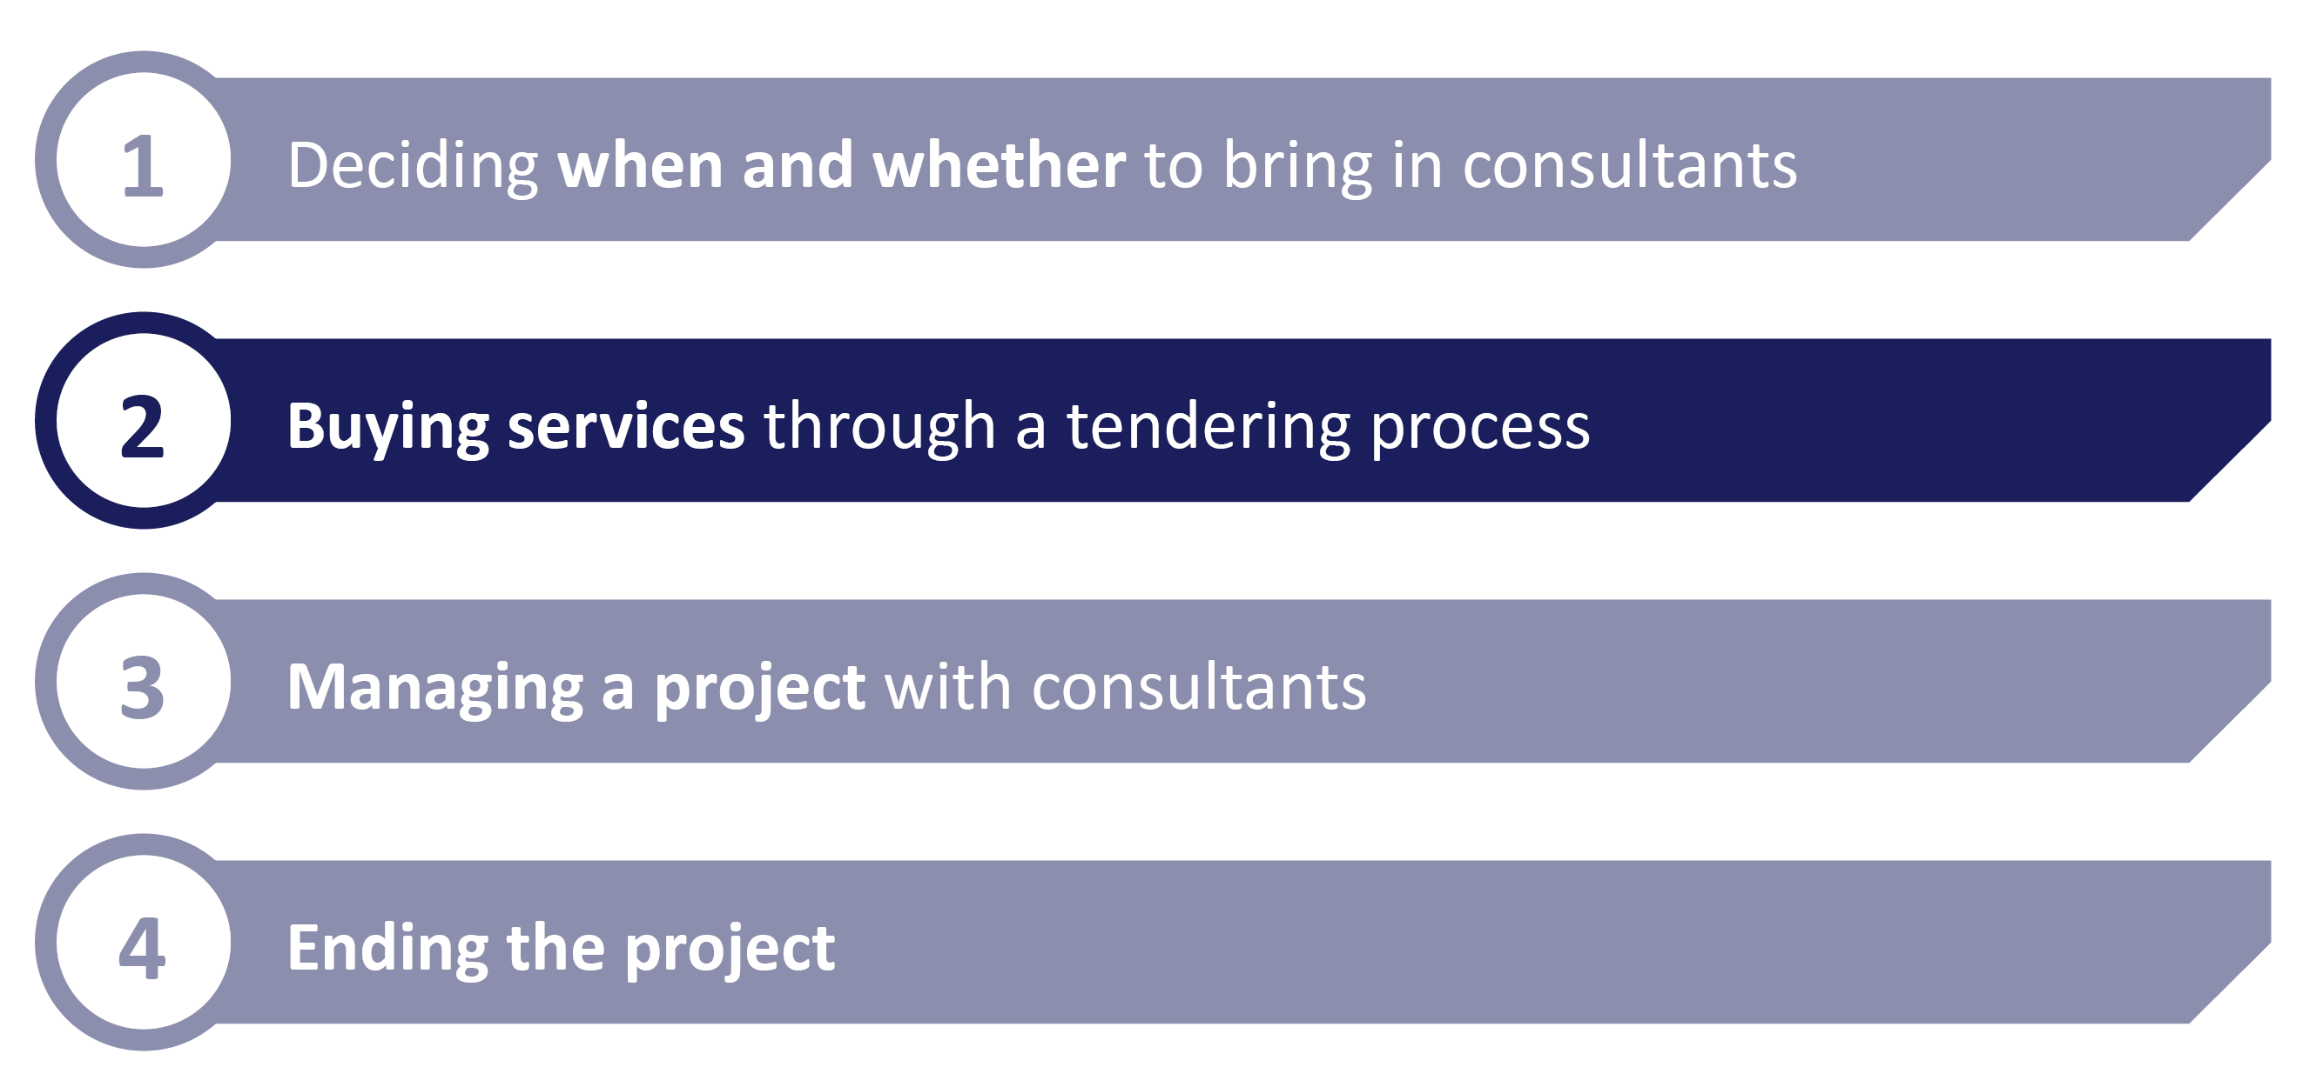
The structure of this report:

Slide 13
Know what you are buying
A project’s success and value are sometimes determined before consultants turn up for their first day. The bidding process is critical to setting up a successful project – and it is the stage where the client has the greatest leverage. There are some key pitfalls to avoid, and ways to make the most of this leverage:
Have clear specifications
Be clear on your responsibilities
Most agreements will include commitments you must meet as the client – for example timely access to people and documents. You need to be confident you can keep to these – if not, you will end up with a bigger bill.
It is critical you have a detailed understanding of what outputs you want to be delivered. Adding or changing later will mean additional costs of the extra work – and you will be in a weaker position to bargain once the project is underway.
Ensure regular ‘deliverables’
Own the intellectual property and analysis
Build regular outputs and products into the agreement. Do not leave them to be defined as the project goes along and delivered all at the end. While it is sometimes right to leave space to adapt or refine these, a project needs clear structure and objectives.
Key tips include:
Regular (e.g. fortnightly) formal review periods tied to outputs
Building in possible remedies if outputs slip
Make sure the contract covers the intellectual property of what is delivered. You should also make sure you agree that the underpinning analysis for each output is shared with you.
You need to know what sits behind the summary findings, what the core assumptions are and why the conclusions have been come to. Asking for this later will likely come at a cost.

Slide 14
Know who you are buying
Most of the time you are – above all – paying for people to come in and do a job. Getting the right team – and the right firm – for the job is critical. It is also the way consultancies will be constructing their price – and attempting to secure profit. Here are some of the most important things to consider as you go through the tendering process:
During the bidding process, you’ll be sent CVs from the supplier. To make sure you get the best team you can, you should:
Get a guarantee that the team proposed in the bid will be the team that turns up on day one.
Meet the core team – most importantly the consultant that will be running the project on a day-to-day basis (in addition to the partner).
Agree the process for approving changes to the team – whether it is because you want to change it or the supplier wants to move people around.
Understand the cost drivers. The time of more senior staff – like partners – will be the most expensive and often are the most easily adjusted to get the right price. A more junior team could give you a lower price.
Getting the right team

Slide 15
Know who you are buying
As well as getting the team right, it is also worth ensuring the consultancy itself is a good fit for the job. Here are some tips on finding the best consultancy for the job in hand
Different consultancy firms generally offer different kinds of services. The bidding process will help you find the right firm, but consider the core services they can offer:
Strategy firms – e.g. McKinsey, Boston Consulting Group – tend, historically, to do shorter more strategic projects.
the ‘Big Four’ – Deloitte, PwC, KPMG, EY – can offer greater scale and variety of resource and generally do more operational focused work.
Specialist firms – those focusing on technology projects or specific policy areas – can provide deep subject matter expertise and experience on a given issue.
In practice, there is increasingly less difference between types of firms – particularly strategy firms and the ‘Big Four’. In some instances, you might want a blended team – breaking up
the tender – to match up the specialisms that different firms can offer you.
What kind of consultancy?

Slide 16
Who has used them before?
It will almost certainly be the case that your department – or others – will have tendered for a similar piece of work in the past. Finding out what they learnt about the process and their project can inform your approach.
Who has done a similar project before?
What did they learn through the process?
What kind of framework agreements exist for this kind of work?
What relationships does your department already have with the likely contenders?
Have these firms performed well before?
The Public Contract Regulations allow the government to exclude companies from bidding on the basis of past performance, but only in very serious circumstances. It is quite unusual for this to be done. But it is important to get a sense – even informally – to know what to expect.

Slide 17
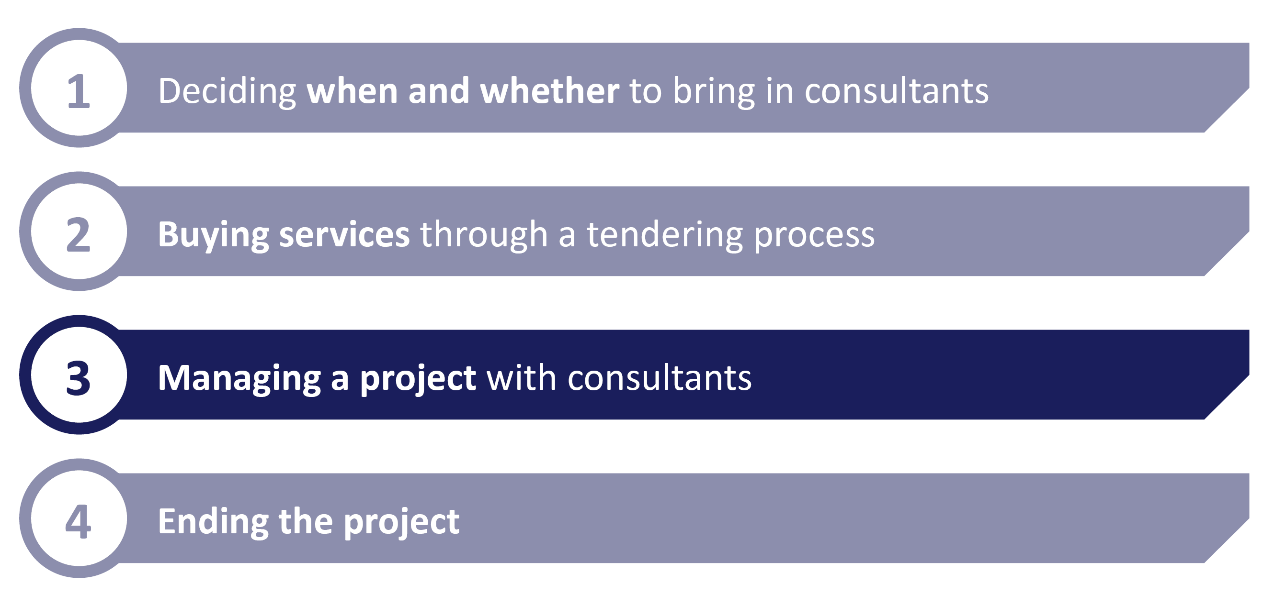
The structure of this report:

Slide 18
Have the right people and processes on your side
Once a project is off the ground it will still require sustained effort from government – it is not just a case of getting the project moving and waiting for the results. No matter how clearly defined the scope and outcomes are, questions will need to be tackled as the project develops. It is key government has the right team in place – at all levels – to support it.
Clear ownership of the relationship – Just as the consultancy team will have a clear day-to-day lead for the project, it is important there is a clear owner on the government’s side. The owner should be involved in the tendering process and be both available and responsible for ensuring the project progresses. Ideally they should stay in place for the duration.
Structures for addressing issues – Difficult questions or issues will almost inevitably surface over the course of the project. You need a clear process for identifying them early, through close working with the team on the ground, and clear levels to escalate. Just as the consultants will likely have senior partners who will engage on most critical issues that arise, you should tee up senior officials to step in.
Resources in place to meet dependencies – You will almost certainly have responsibilities and dependencies within the contract, from providing data to timely access to individuals within the department. You need dedicated resources in place to ensure you can keep to your side of the contract – any delay could cost you.
Senior support for regular reviews – The contract should provide for regular outputs and assessments to judge progress as things progress. Senior support and attendance can help sure deadlines are met – consultancies will want to keep positive relationships with senior clients in the department.

Slide 19
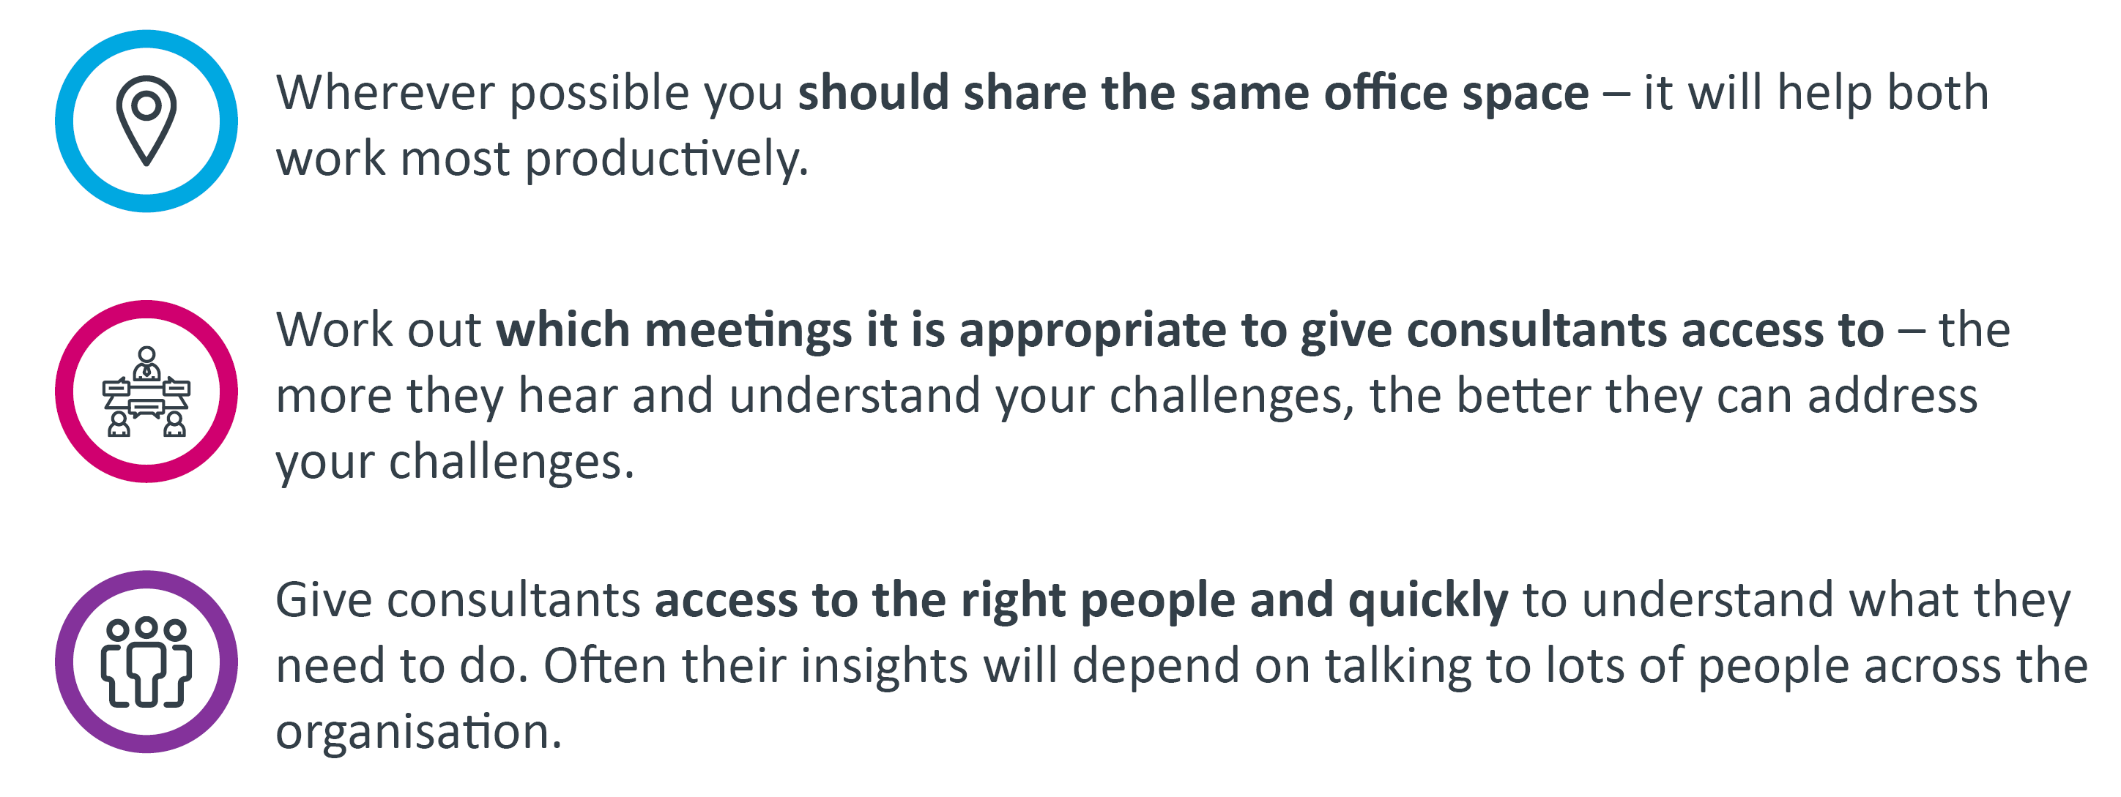
Give consultants the support and access they need
Consultants are more likely to give you the analysis and insight you need if they can understand your challenges, questions and organisation. By giving them good access to the organisation and working closely with them, you can ensure their work is better tailored to you.

Slide 20
Establish a process for managing performance
Throughout the project it is important to have a mechanism for carefully managing progress.
The consultant team may unearth issues that need to be addressed to support their work or timelines may not be met as intended. There are some things – many already mentioned – that can help track progress.
1
Agree clear, regular outputs as part of the contract – not relying on them all being delivered at the end of the project.
2
Agree a remedy process – if government fails to meet its dependencies or if deliverables fall behind track (for example, consultancy being expected to provide additional resources to catch up).
3
Agree regular review points – e.g. fortnightly – to discuss progress and assess outputs.
4
Agree a structure that lets you escalating questions or concerns – with senior people appointed on each side.

Slide 21
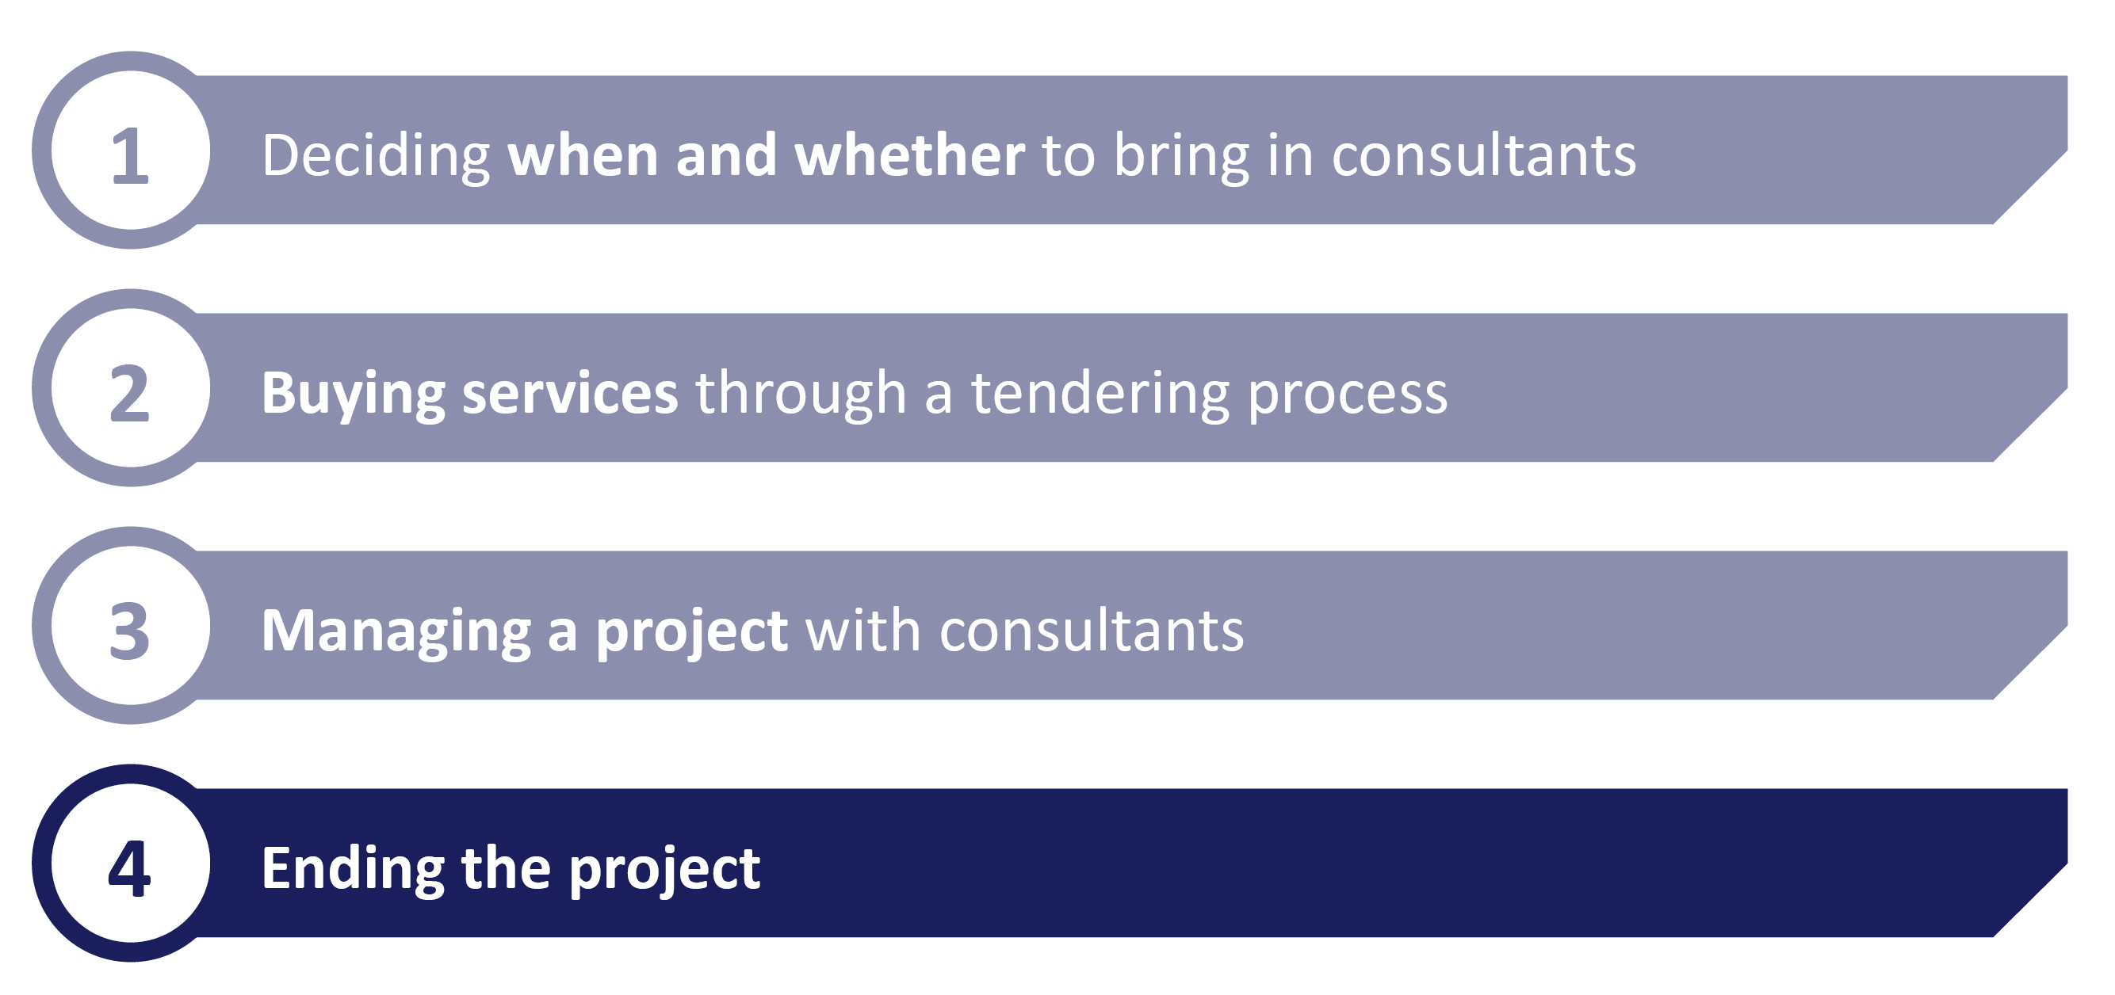
The structure of this report:

Slide 22
Prepare for the end from the beginning
As a project ends and consultants hand over the work they’ve done, there is a risk that you either pick up their work with too little understanding of how it was done – leaving you dependent on the consultants for the next stage – or the product simply sitting unused. It is important to look to avoid this from the very outset of the project. Key considerations are:
Include staff training as part of the tender
During the tendering phase, you should request that the consultant team build in a programme of training and skills sharing for your team. For example, if they are coming to provide a specific capability such as programme management, you should request tailored sessions on that discipline. If they are developing or using management tools, make sure they train your staff in them.
Ensure underpinning analysis is shared and explained
Right from the outset it is key that you get access to the underpinning analysis and information that drives the consultant’s outputs – whether it is source code for software or models and assumptions. This access should be explicitly stated in the contract. If the findings will inform key decisions, you need to be able to back them up long after the project has closed out – so in depth understanding is key.

Slide 23
Make the ‘sell on’ work to your advantage
Identifying new work – once already on the ground – and selling it to the client at the end of the project is a key part of the consultant’s business model. This is known as the ‘sell on’. You should recognise this from the outset and use it to your advantage. It is another key point of leverage for you as a client.
Structure the project
In some cases you might want to structure the project into shorter chunks, selling a short piece of work that can be extended as opposed to a single longer-term contract. This increases your points of leverage throughout the process, but does mean more work from a commercial perspective.
Listen to the ‘sell on’
Not only will it send a potentially unhelpful message if you rule out any ‘sell on’ from the outset of the project, you might find the consultants identify some useful work or issues you hadn’t considered. After spending time in your organisation, they should have the information required to make constructive suggestions – even if you don’t end up buying further work.
Guide the discussion
If you are aware of areas where more work might be needed, let the consultants know. They will likely go out of their way to prove their credentials, so might provide you with some valuable – but free – insights that can inform your work. Likewise, it helps you better understand what you might need from any further project.
But avoid becoming captured by a single team or consultancy. If you do want further work, you should always consider the steps and questions set out earlier in this report.

Slide 24
A guide to managing consultants
This report was intended to provide high-level and practical tips for those in government working with consultants, rather than offering detailed analysis of the government’s use of consultants or recommendations for reform.
There are already other, more in depth studies of how government contracts with suppliers. For example:
Outsourcing Playbook, Cabinet Office
Use of Consultants and Temporary Staff, National Audit Office
If you have recommendations for how government could better work with consultants that you think should be included, please contact the Institute for Government.
The Institute’s work in this area
The Institute has published in depth analysis of public procurement, outsourcing and insourcing. For more information on this area of our work, please go to our website:
www.instituteforgovernment.org.uk/our-work/policy-making/government-outsourcing
Contact: Nick Davies (nick.davies@instituteforgovernment.org.uk)

Slide 25
Managing Consultants
For further information:
www.instituteforgovernment.org.uk
+44 (0) 20 7747 0400
+44 (0) 20 7766 0700
@instituteforgov
enquiries@instituteforgovernment.org.uk
Institute for Government 2 Carlton Gardens, London, SW1Y 5AA United Kingdom

