Slide 1
Corridors of Growth in a Polycentric City Region
Tony Reeves,
Chief Executive of Wakefield Council

Slide 2
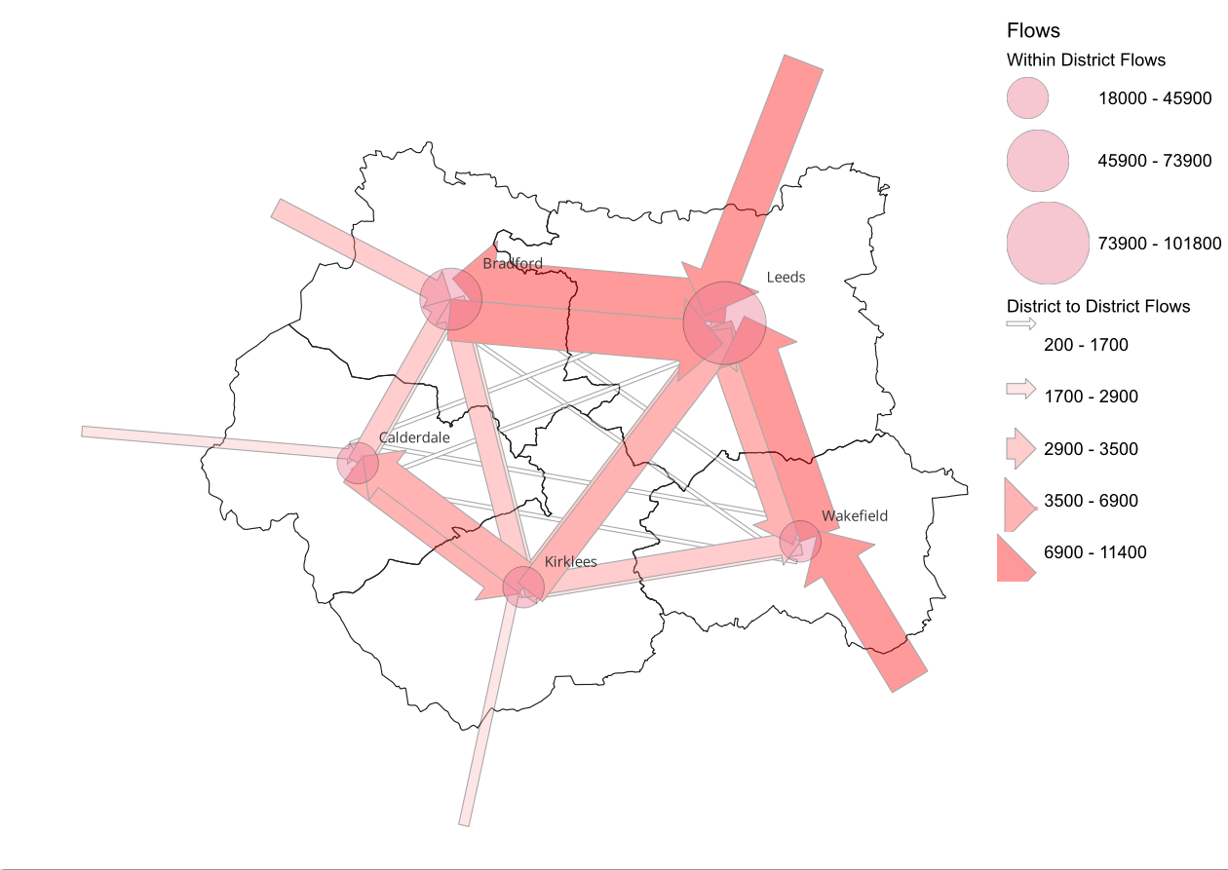
Leeds is the dominant commuter destination with West Yorkshire, however there are also significant flows between adjacent districts
Figure: Indicative modelled commuter flows to / form and within West Yorkshire
Leeds to Bradford has the strongest two-way commuter flows within West Yorkshire
There are large inflows of commuters from York & Harrogate to Leeds, and Doncaster to Wakefield
There are significant commuter flows between adjacent districts, but lower levels of commuter flows between non-adjacent districts (i.e. Calderdale to Wakefield)
Source: West Yorkshire Strategic Transport Model, Base year 2023 model

Slide 3
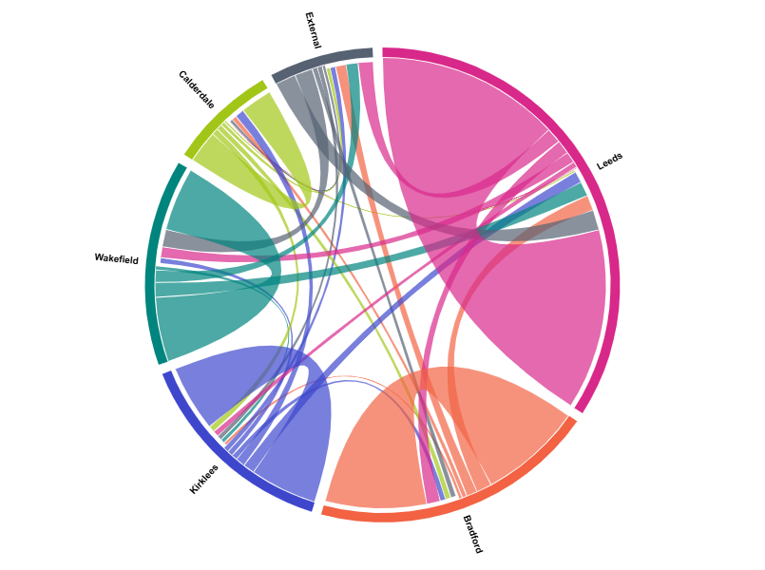
Leeds is the dominant commuter destination with West Yorkshire, however there are also significant flows between adjacent districts
Figure: Indicative modelled commuter flows to / form and within West Yorkshire
Over 8,000 commute trips between Wakefield and Leeds
Leeds to Bradford has the strongest two-way commuter flows within West Yorkshire
Large inflows of commuters from external areas to West Yorkshire, with the largest flows being from York & Harrogate to Leeds, and Doncaster to Wakefield
There are significant commuter flows between adjacent districts, but lower levels of commuter flows between non-adjacent districts (i.e. Calderdale to Wakefield)
Source: West Yorkshire Strategic Transport Model, Base year 2023 model

Slide 4
Leeds is the key destination for Wakefield commuters, based on recent travel data
Figure: Indicative modelled commuting flows for Wakefield by direction of commuting
Two-thirds of commuting flows originating in Wakefield have a destination within Wakefield itself.
In terms of commuting destinations external to Wakefield, Leeds is the principal one, with parts of South Yorkshire and Kirklees also significant.
The commuting flows into Wakefield from Leeds are also substantial.
There is a net outflow to Leeds, but a net inflow from all other areas (except York / East).
Source: West Yorkshire Strategic Transport Model

Slide 5
Between 2019 and 2023 the region’s economy grew faster than the UK average, led by Leeds and Wakefield
Figure: Real economic growth: Chained Volume Measure gross value added
West Yorkshire’s economy grew at twice the UK average rate in the 2019-2023 period (latest data available).
The main sources of GVA growth were Leeds and Wakefield, followed by Kirklees.
The rate of growth moderated in 2022-23 as the energy crisis prompted by the invasion of Ukraine hit output (GVA growth in West Yorkshire fell to 0.4%).
Growth in the latest 2019-23 period remains well below the rate seen before the financial crisis.
Source: ONS, Regional gross value added (balanced) by industry: all International Territorial Level (ITL) regions

Slide 6
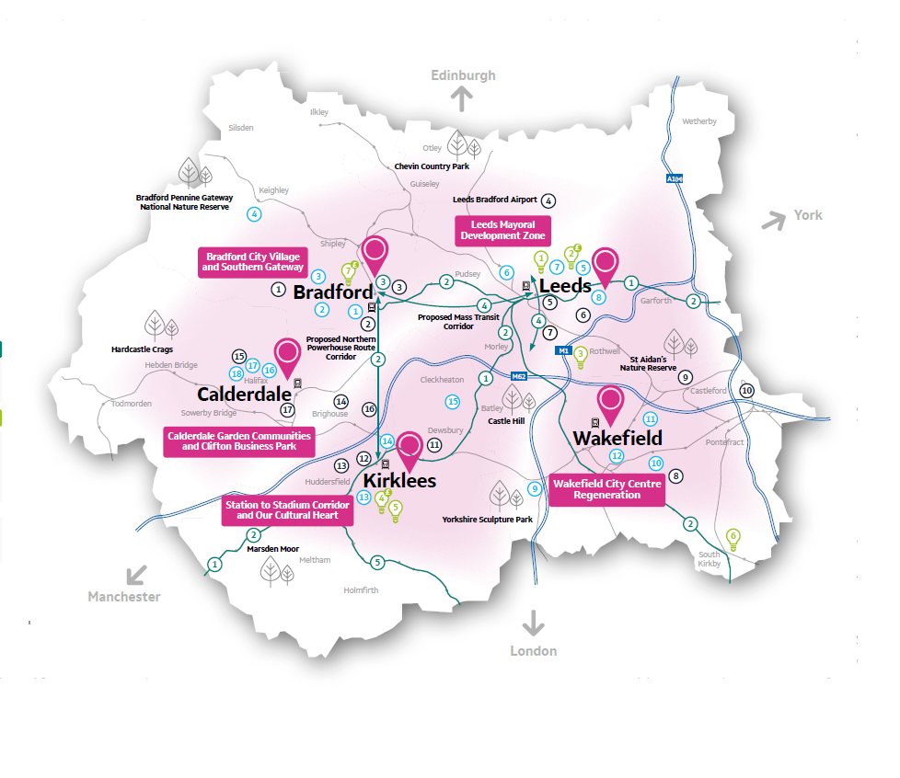
Transformational Growth in West Yorkshire

Slide 7
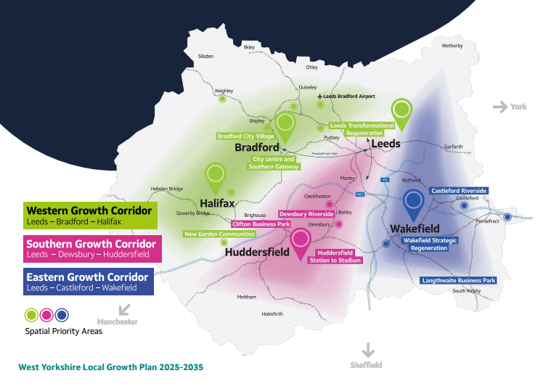
West Yorkshire Local Growth Plan - Corridors of Opportunity

Slide 8
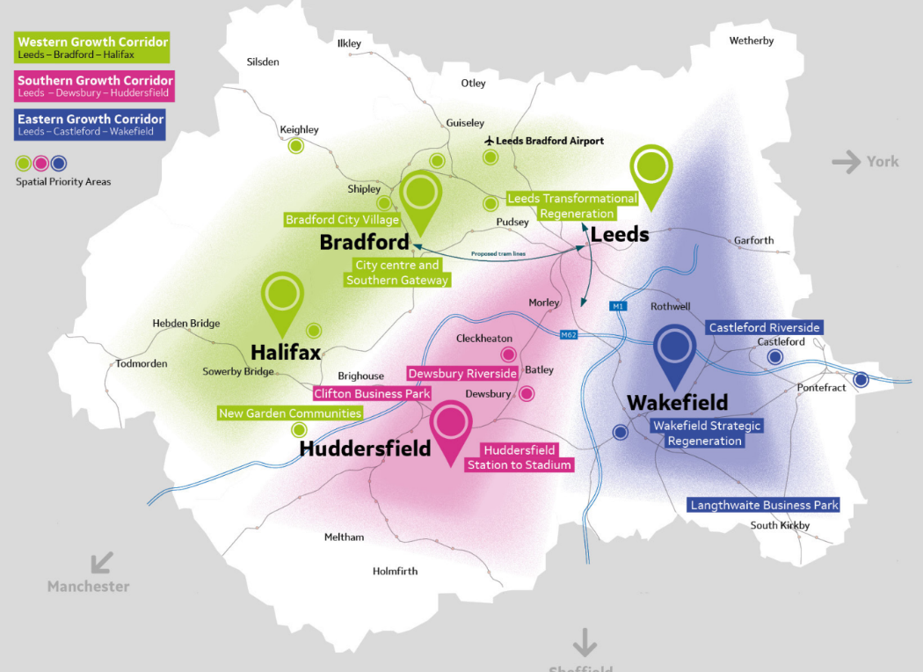
Corridors of Opportunity and projected development of Spatial Priority Areas
Leeds Transformational Regeneration Partnership: 50,000 homes focused on the city centre and aligned to substantial infrastructure investment in mass transit and rail
Bradford Southern Gateway: Up to 5,000 homes / 126 ha / 440,000 sqm office / 253,000 sqm industrial and manufacturing
Bradford City Centre and City Village: 1,500 homes / 25ha
Development aligned to substantial investment in mass transit and rail (Bradford through station)
Wakefield Regeneration Partnership: Regeneration partner secured and actively engaged to maximise housing led regeneration for Wakefield City Centre
Castleford: 3,000 homes / 2,000 jobs 15.91 ha employment land
Langthwaite: 9.45 ha employment land GVA £83.2m
North Halifax Transformation: 1,600 homes
Clifton: 1,300 jobs / GVA £42.6m
New Garden Communities: 2,000 homes (Bradley) 1200 homes (Woodhouse)
Dewsbury Riverside: 4,000 homes, 165ha
Huddersfield Station to Stadium: Key location in West Yorkshire Investment Zone, work in progress to align innovation and commercial activity to housing growth opportunities

