Slide 1


Slide 2


Devolution and Loal Power for Communities in North West England
Institute for Government
DEVO LAB #6
14th July 2026
James Johnson
Head of Regional Programme

Slide 3
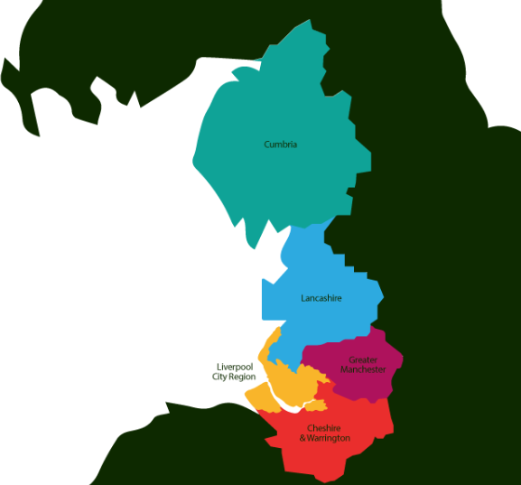






Slide 4


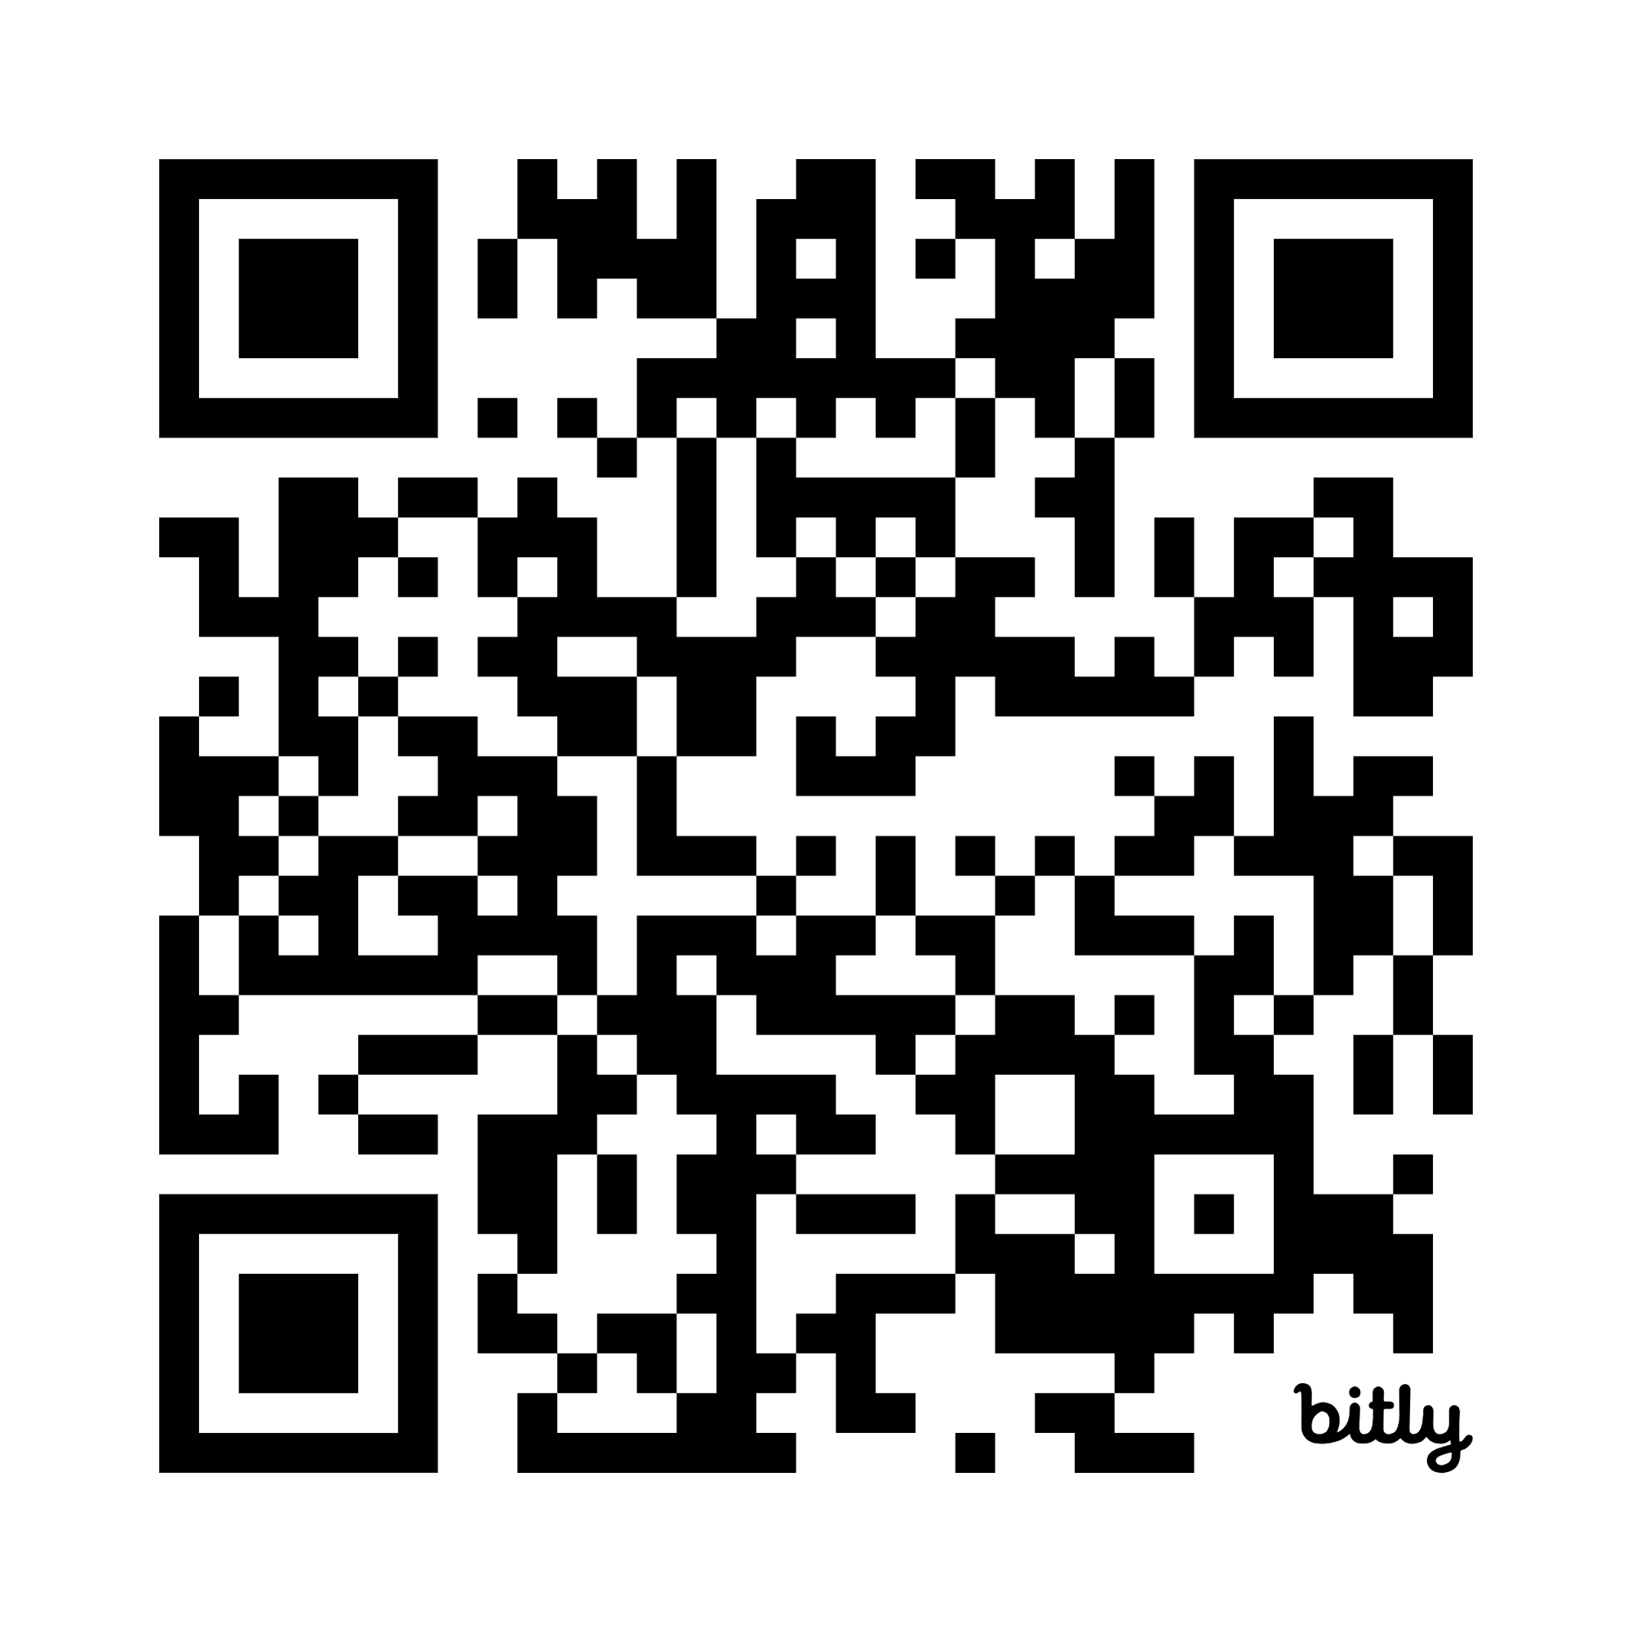
www.nwnetzerohub.org.uk / https://bit.ly/4n0YWtT

Slide 5
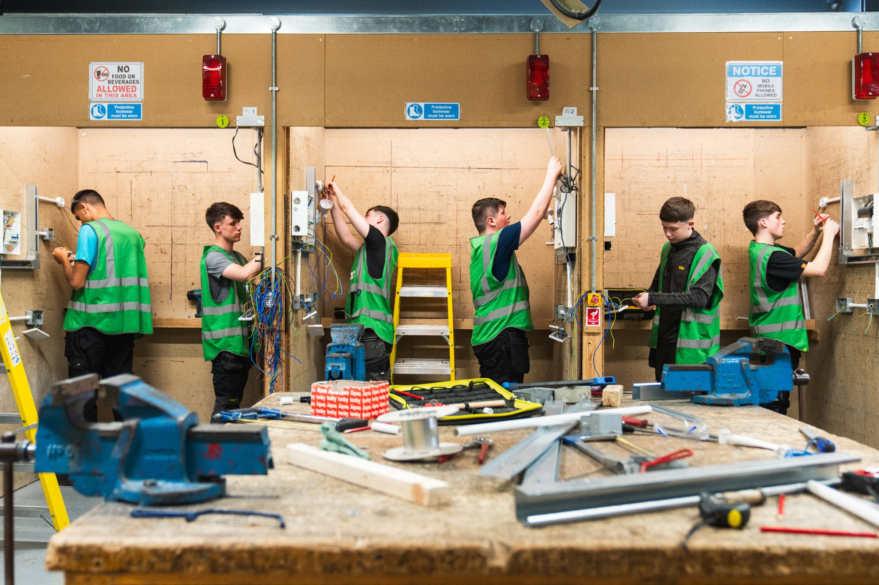
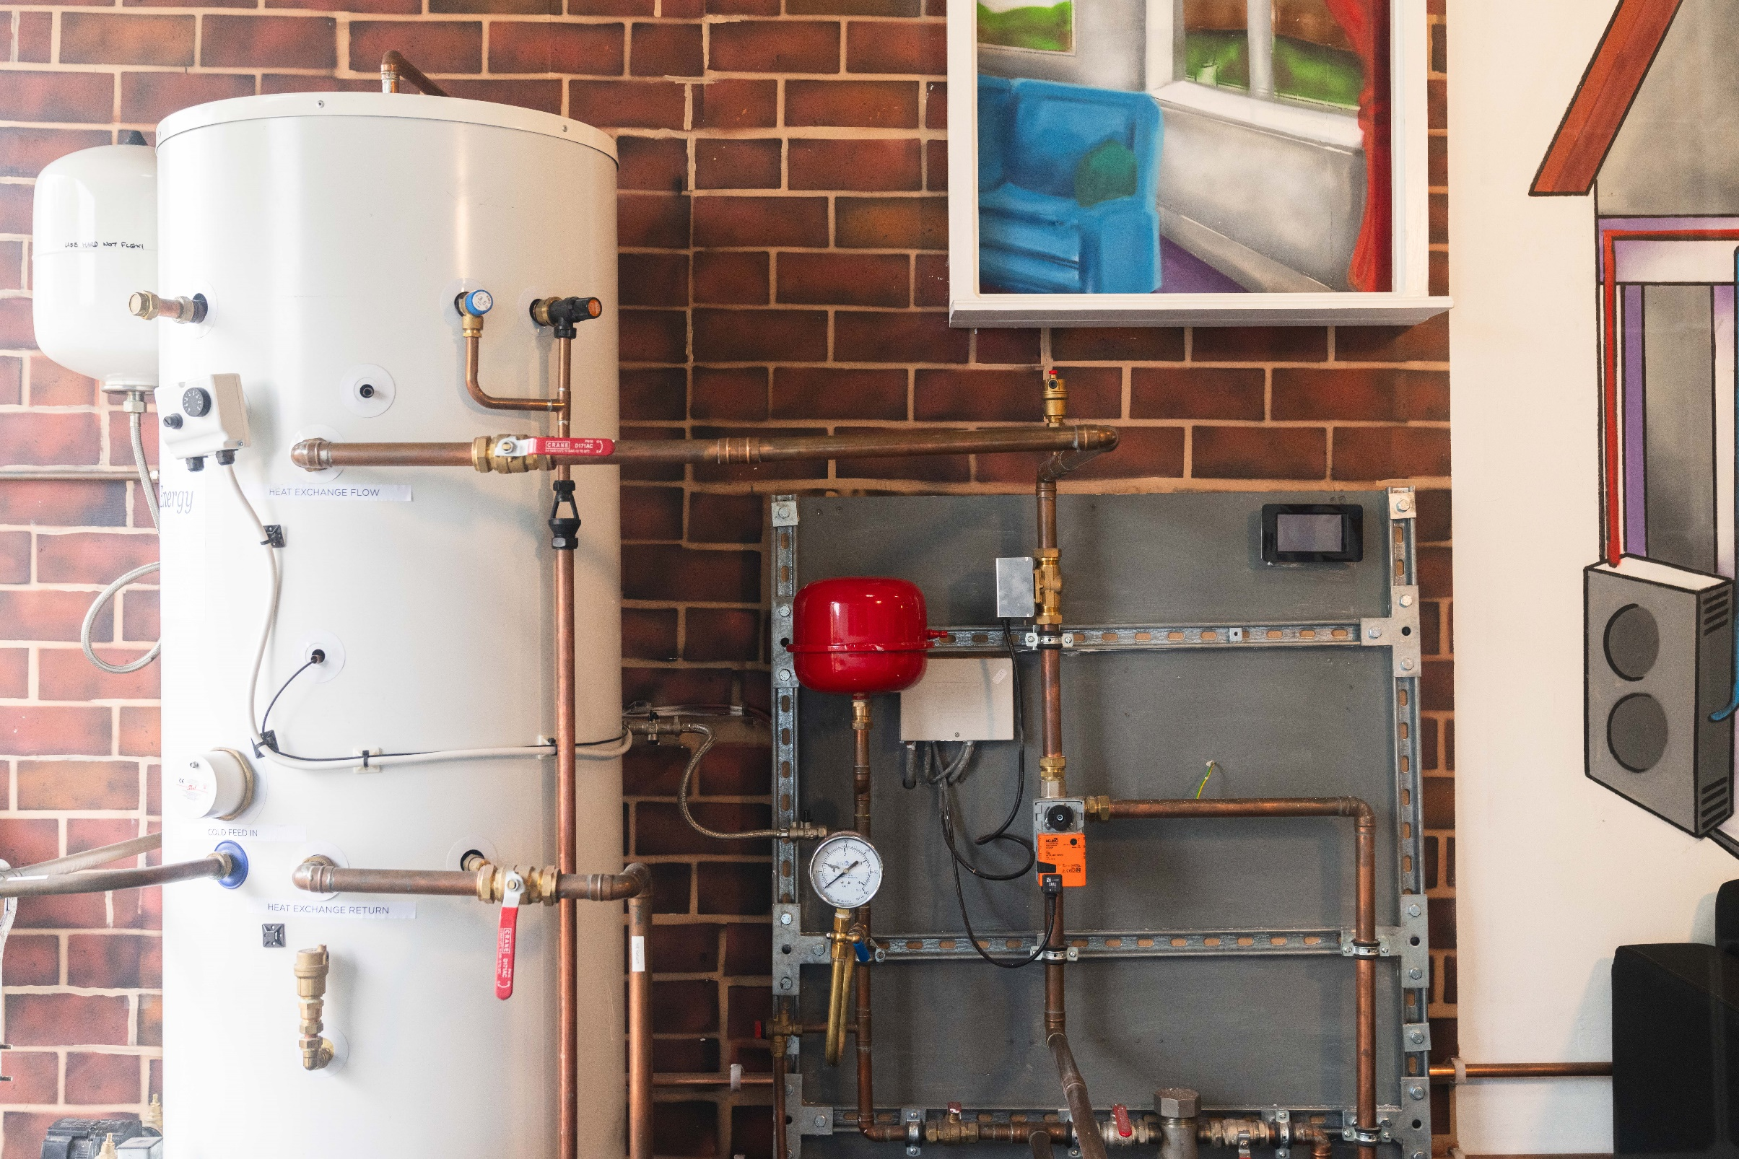

Economy
Sectors
Cross-Cutters
LOCAL GROWTH
RESIDENTS & COMMUNITIES
BUSINESS SUPPORT
GREEN FINANCE
SPATIAL PLANNING
WORKFORCE & SKILLS
ENERGY NETWORKS
RETROFIT
NON-DOMESTIC BUILDINGS
INDUSTRY
TRANSPORT
MAJOR INFRASTRUCTURE
INNOVATION
RENEWABLES
HEAT
ENVIRONMENT
RESOURCES & FUELS

Slide 6




Local energy planning for a place-based approach

Slide 7



Clean Power 2030 Action Plan
NESO
Warm Homes Plan
Warm Homes Agency
Local Power Plan
Great British Energy

Slide 8

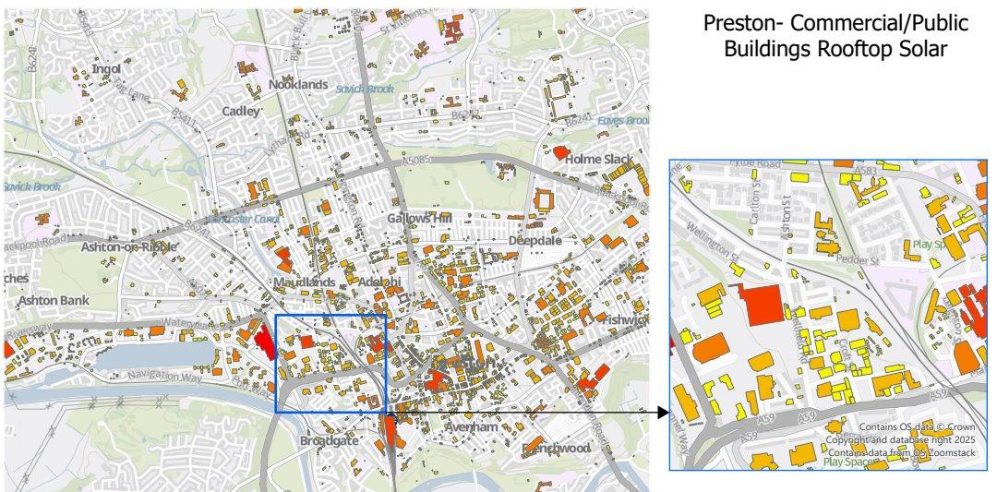
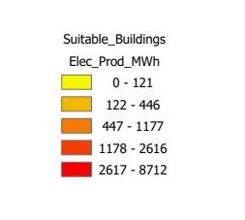
Example of local authority solar assessment plan

Slide 9


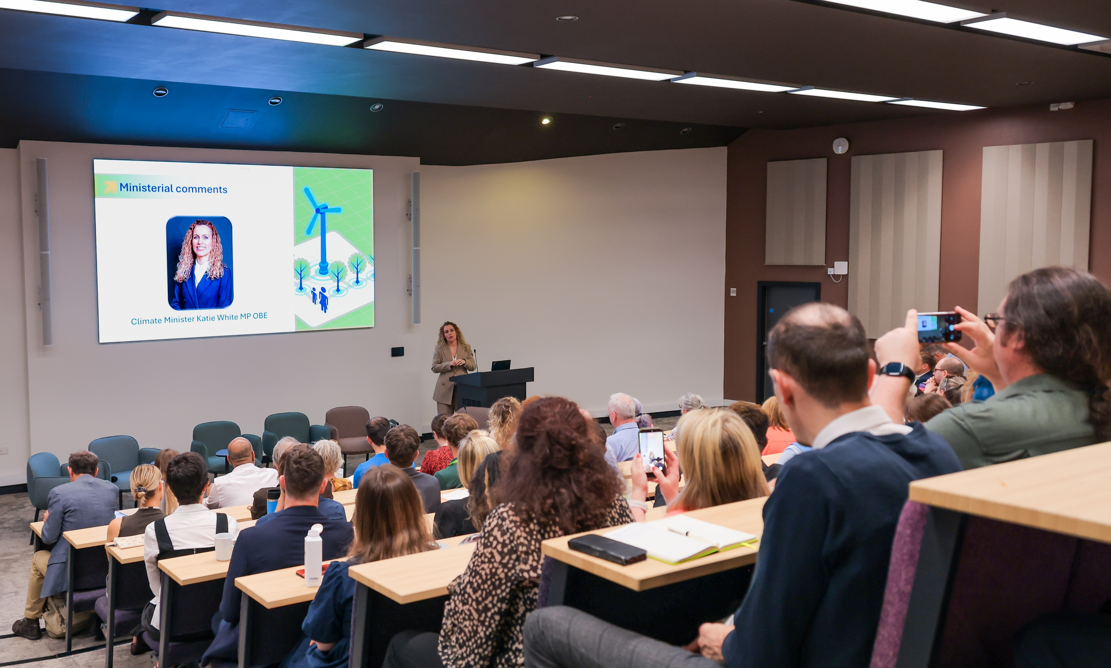
Energising Britain
JULY 2026 - 800+ Delegates - 5 events,
ATTENDED BY THE MINISTER FOR CLIMATE
Cross-sectors including Youth, Faith, Culture
FOCUS ON ELECTRIFICATION

Slide 10
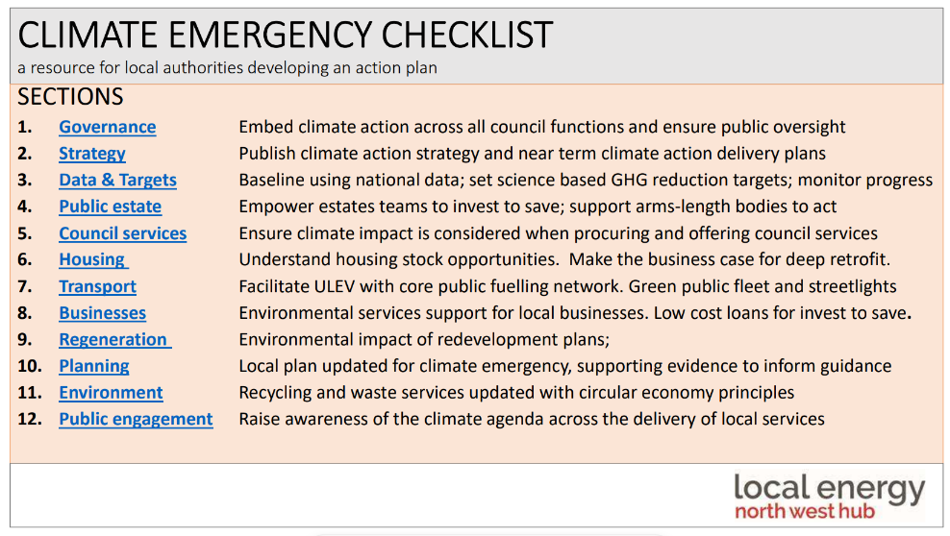

Slide 11
www.nwnetzerohub.org.uk / https://bit.ly/4n0YWtT

