Slide 1


Making growth work through places
Sheffield, South Yorkshire and the messy middle of devolution
With Kate Josephs, CEO of Sheffield City Council

Slide 2
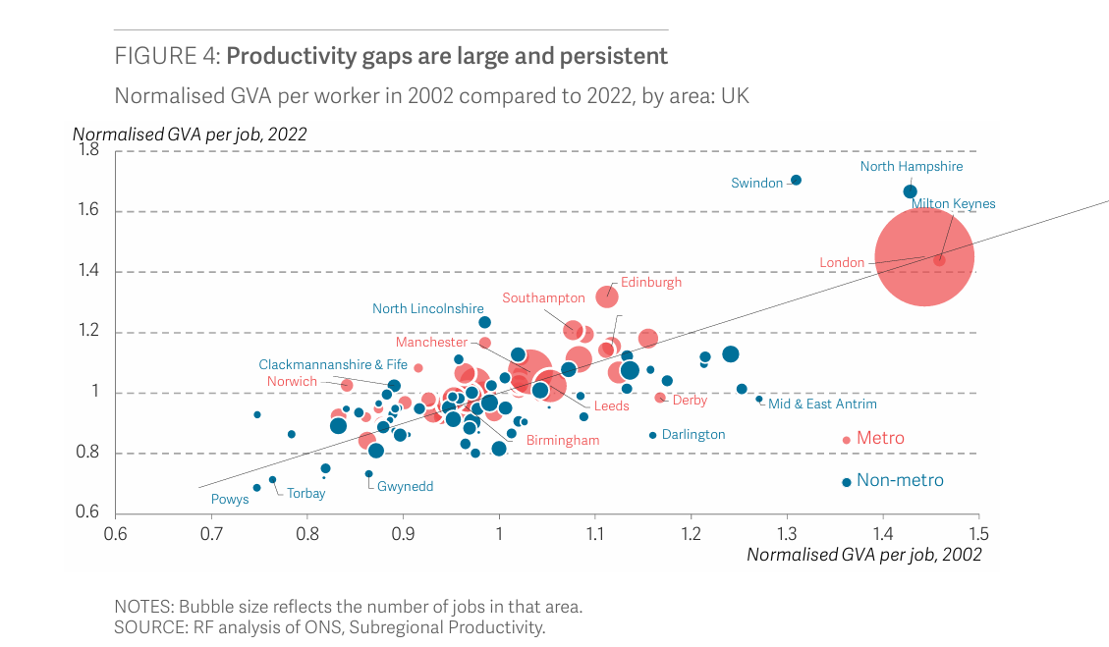
Why does growth matter?
And where does it land...

Slide 3
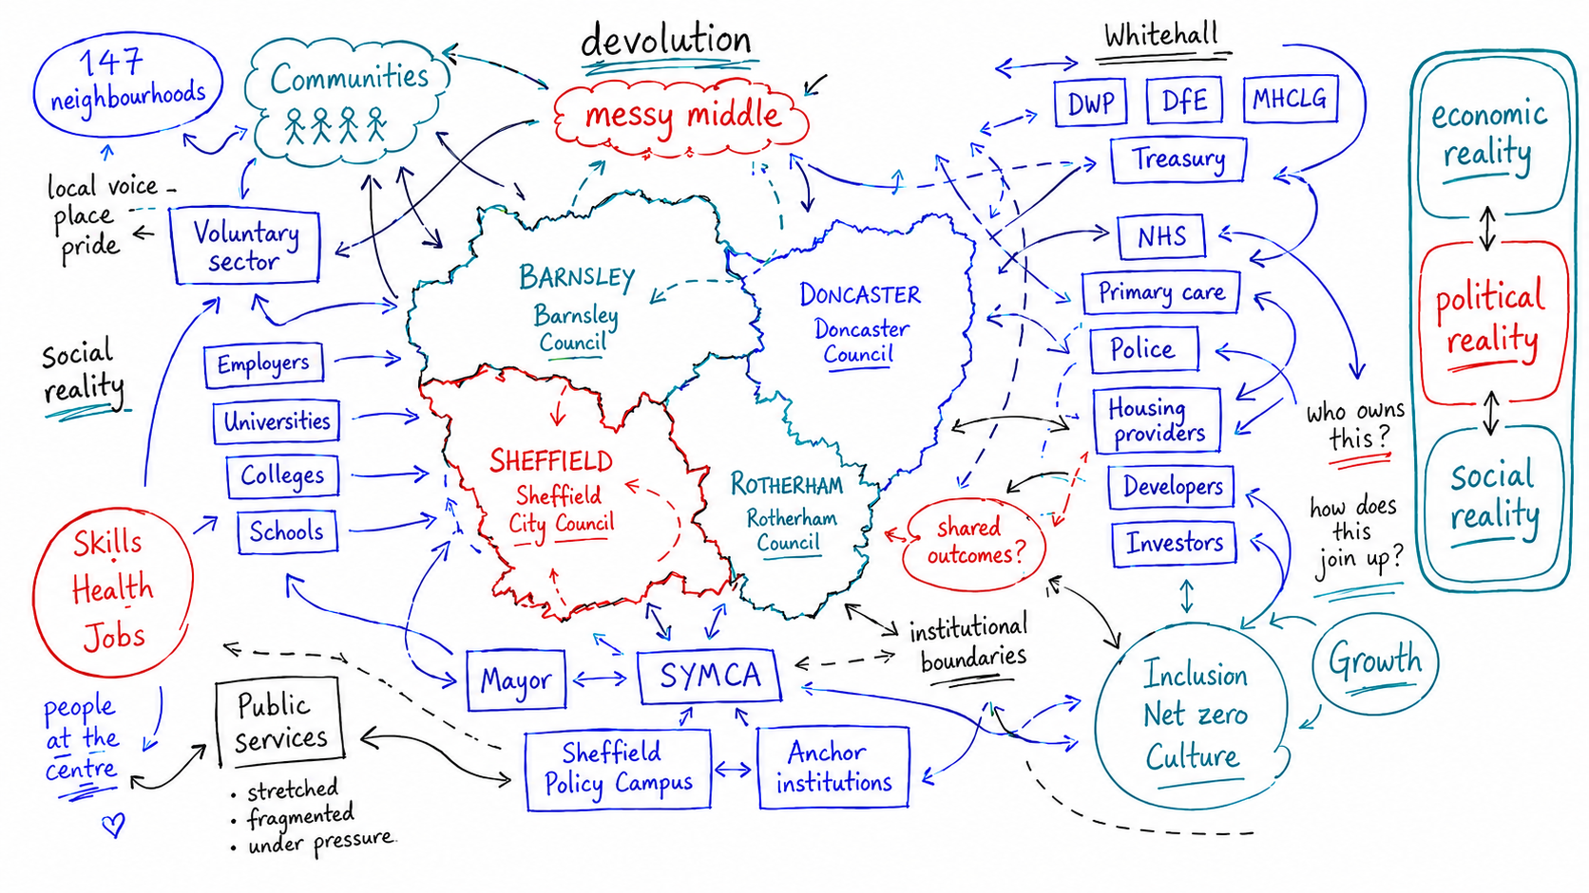
The Messy Middle
The question is not just where power sits, but whether places can use it to work across the system...

Slide 4



Why a South Yorkshire Strategy?
To connect the things that no one place can do alone: opportunity, health and pride in place.
Stay Near and Go Far
Healthiest Region in the country
Connected and Proud
Communities

Slide 5






Case Study #1: Sheffield City Goals

Slide 6
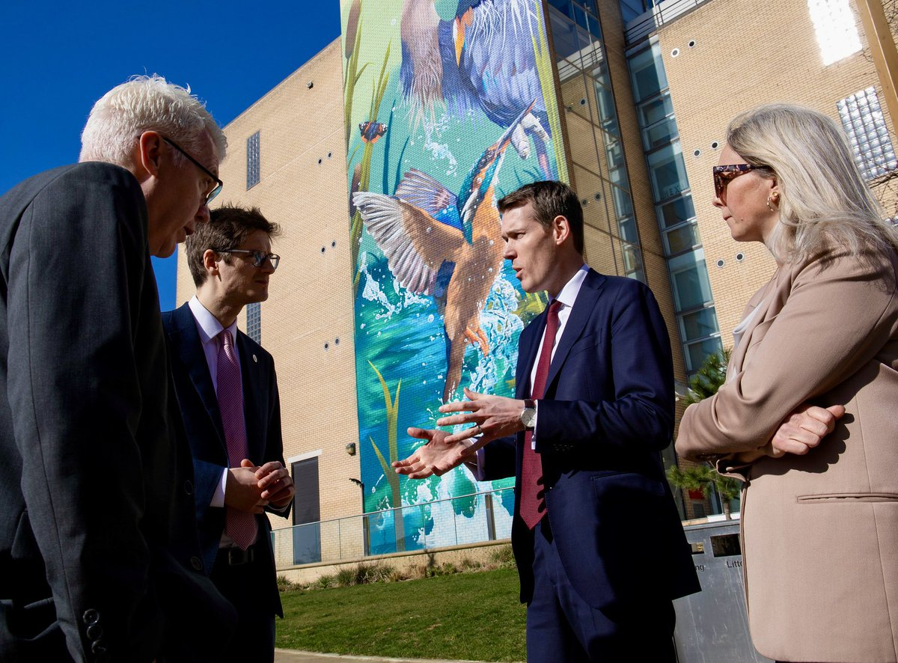
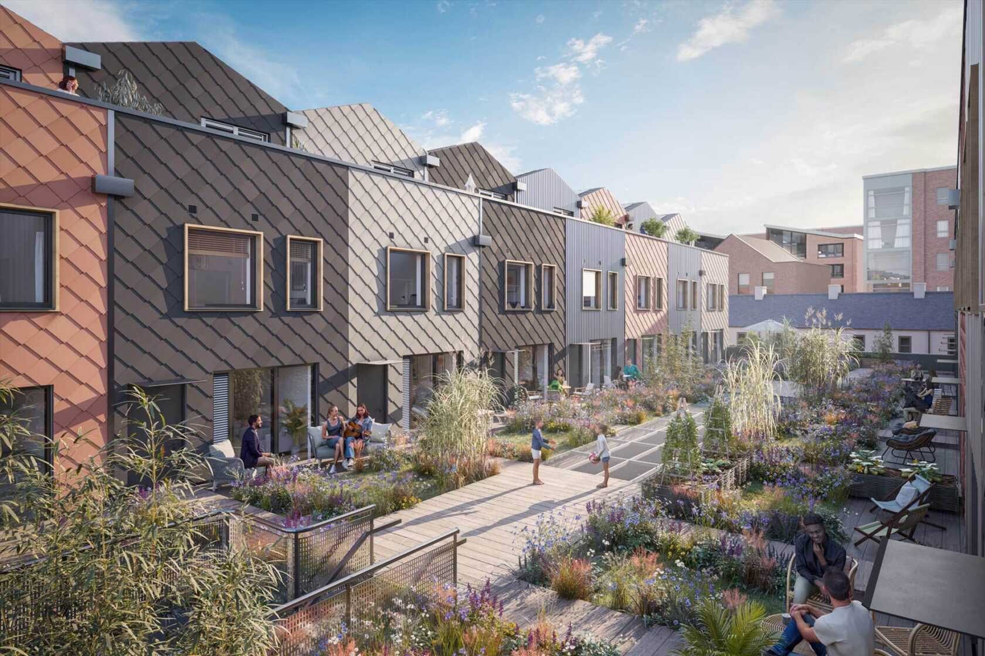
Case Study #2: Sheffield Together
July 2026:
Targeting 38,000 homes by 2039, including c.20,000 in the city centre
c.2,000 homes in active development, with 10,000+ starts being triggered across the pipeline
Gleadless Valley: c.1,100 new homes over the next decade, alongside green space and community infrastructure
South Yorkshire scale-up: £700m funding envelope confirmed to support 9,000 affordable homes across the region

Slide 7
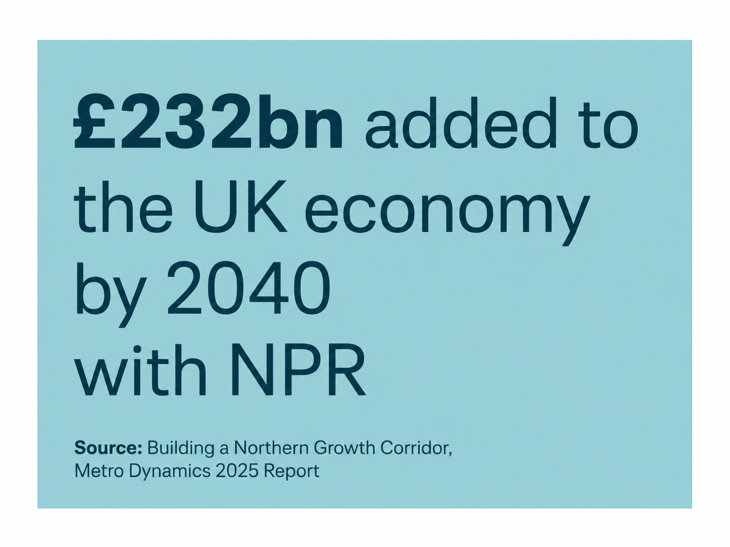
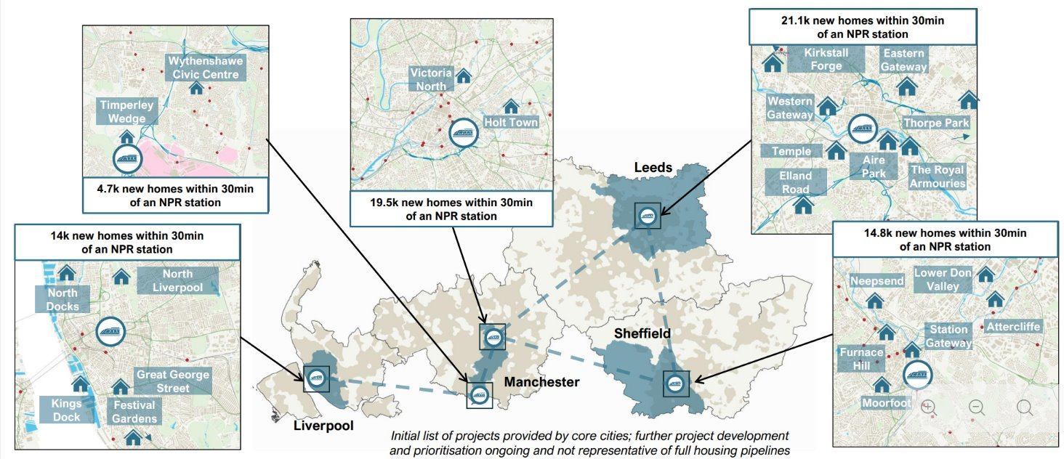
Case Study #3: Northern Growth Corridor
The next phase of northern growth is not just about bigger cities. It is about better connections between them.

Slide 8
Notes From the Messy Middle...
Start with trust, not just strategy
If people do not trust the process, they will not believe the plan.
Be honest about difference
Regional strategy should not flatten places into one neat story.
Use scale where it adds value
Transport, skills, housing, investment and fiscal asks need regional weight.
Make institutions behave differently
The test is whether partners align assets, decisions and delivery, not just language.
Keep asking where growth is felt
Growth has to show up in homes, streets, communities and futures.

