Slide 1
West Midlands
Local Net Zero Accelerator
Barbara Leach
LNZA Programme Manager
West Midlands Combined Authority

Slide 2
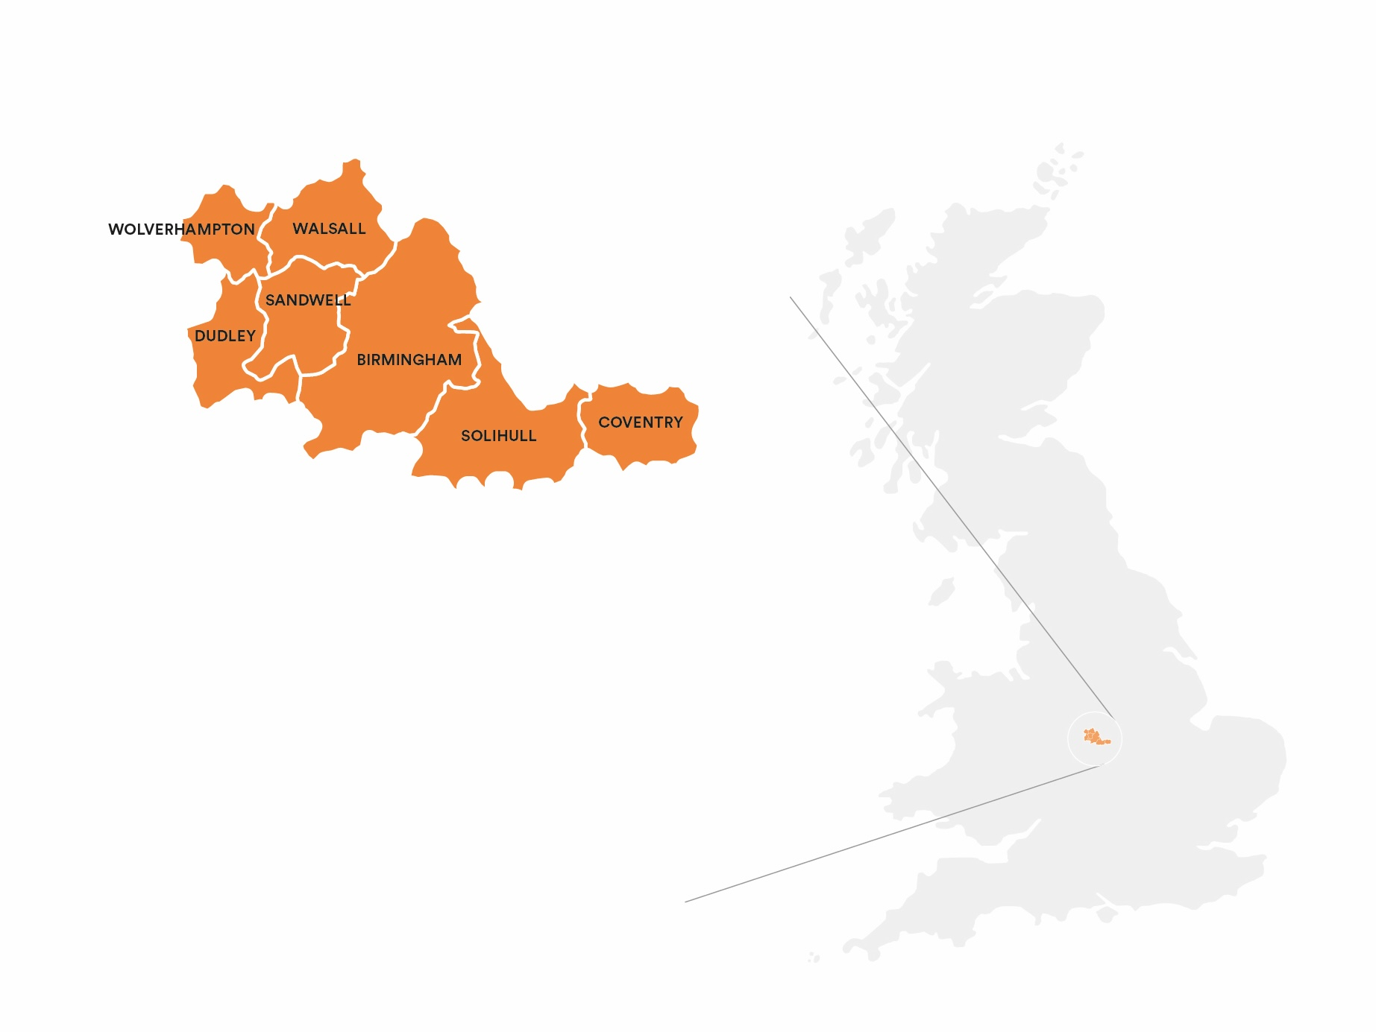
WMCA

Slide 3
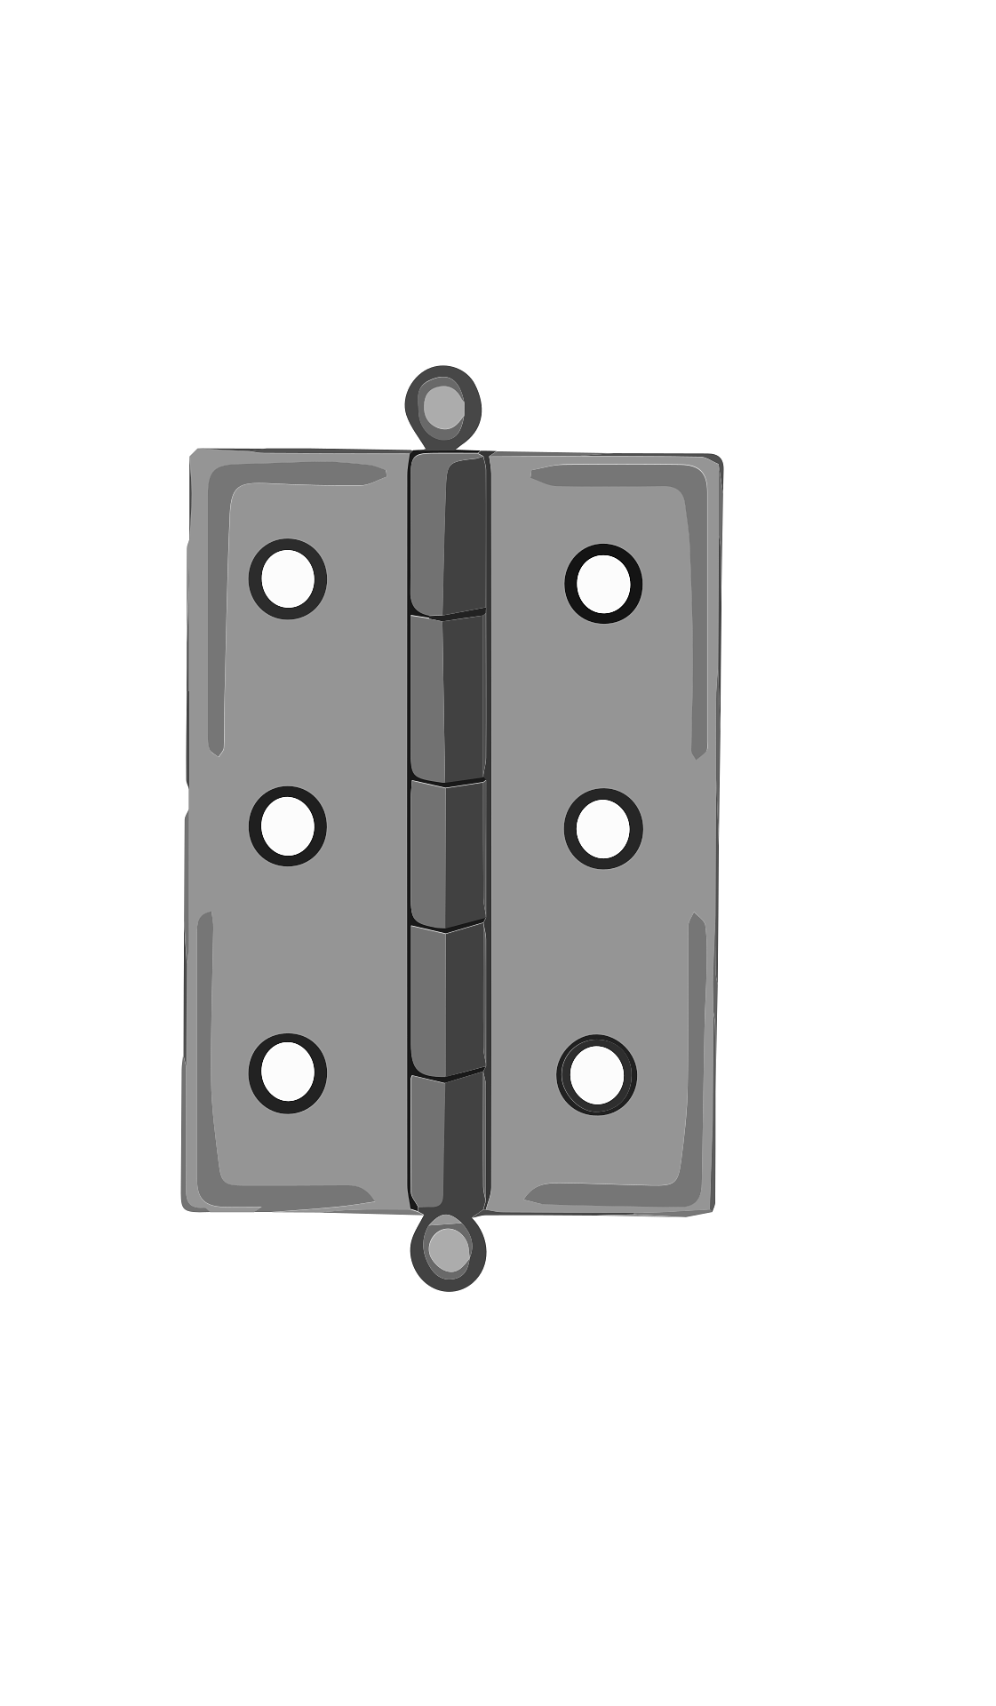














The investor context
INVESTMENT OPPORTUNITIES
DECARBONISATION REQUIREMENTS
THAT COST MONEY
Icons created
by Leremy
available at www.flaticon.com

Slide 4




The WM LNZA proposition
1. Well-governed attractive investment vehicle,
capable of blending finance
2. Project pipeline, attractive to investors, and capable of bundling projects
3. Local places accepting and welcoming of change with no one left behind
4. Reliable data on outcomes suited to impact investor requirements

Slide 5
Investment vehicle

Slide 6
Complex public funding landscape
Treasury
DESNZ
MHCLG
PWLB
NWF
INTEGRATED SETTLEMENT
WHA
GBE
NZ Hubs
Mayoral strategic authorities
Local authorities
Local community organisations

Slide 7

Transformational funding?
Private investment?
Other repayable finance e.g. PWLB
Grants
CDEL FT
Repayable capital

Slide 8
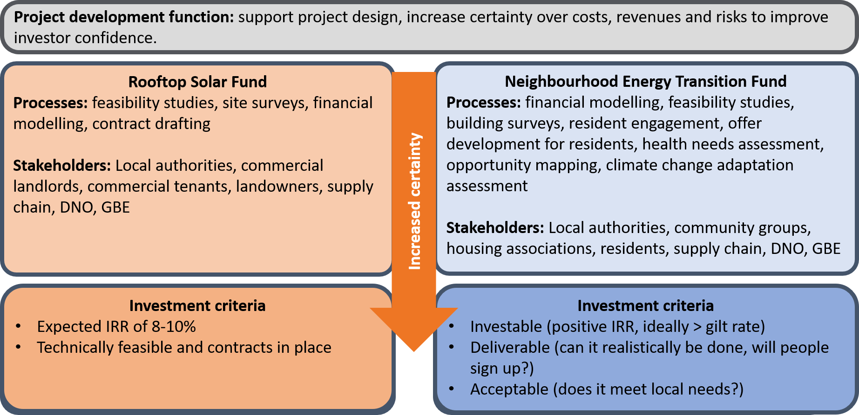
Proposed Funds

Slide 9
Credible pipelines of projects

Slide 10

We have opportunities but
not attractive pipelines of projects

Slide 11
Projects need developing
Idea or
concept
Project
Developed project
Investment ready project
Commercial
model
Business case covering planning, legal, and procurement matters, revenue and risk allocation
Sponsor
Place
Delivery route
Initial feasibility
Capital
requirement
Initial costing
May be opportunities
Worth discussing

Slide 12
Place-based delivery

Slide 13
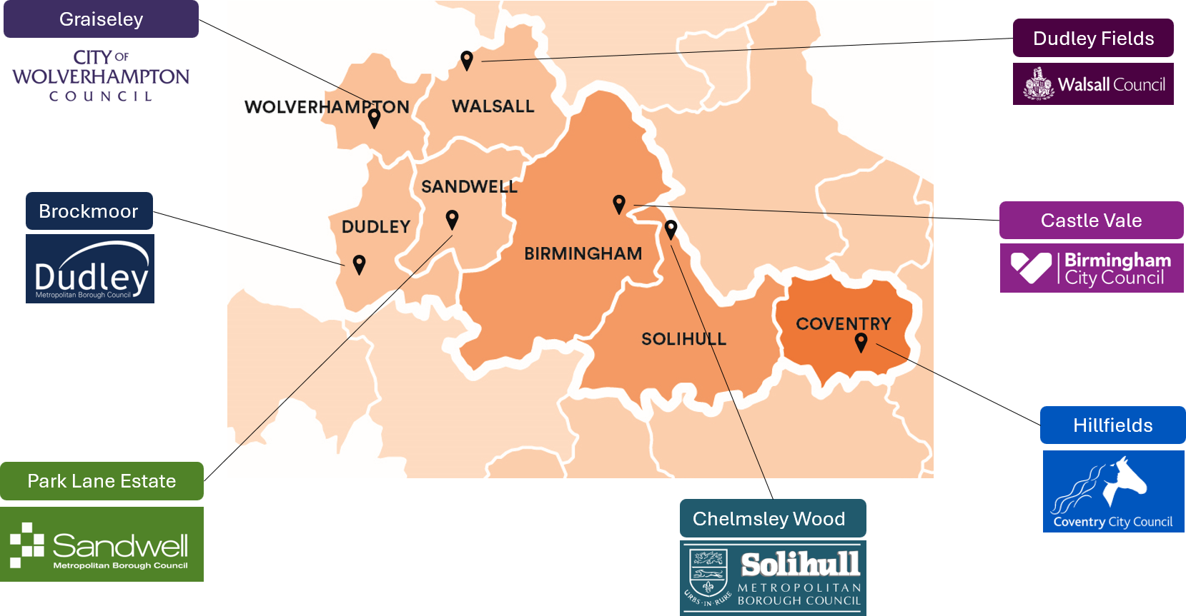
Communities are critical to success

Slide 14
Events and resources

Slide 15

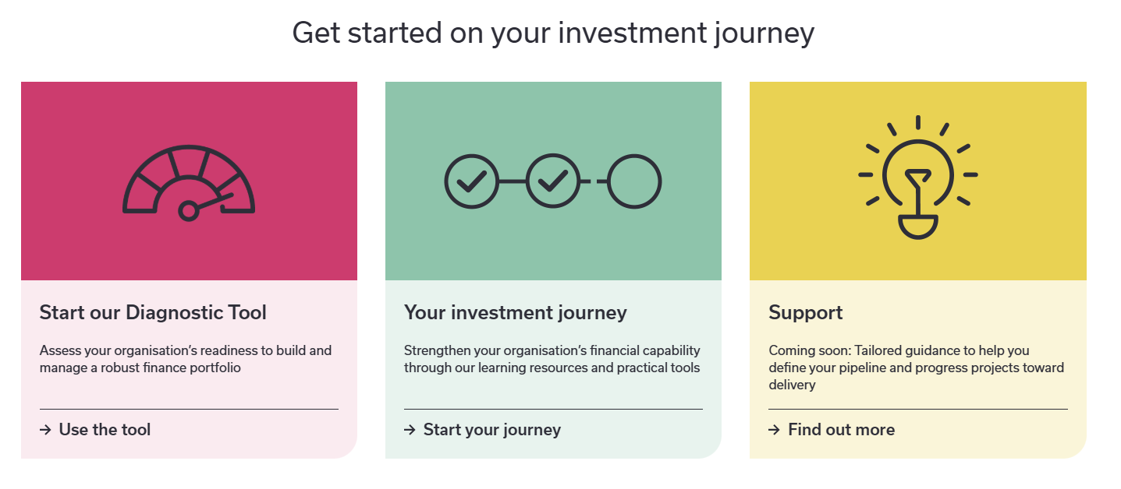

fit4finance.org.uk

Slide 16
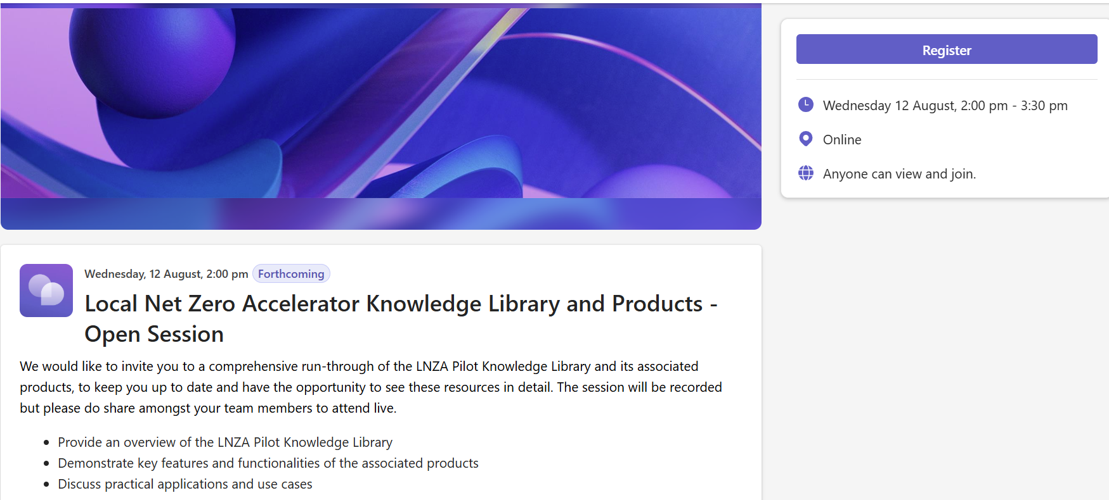
Training from GSENZH

Slide 17
Opportunities to hear more
4 August Policy Briefing: Using the Warm Homes Fund to enable the UK's neighbourhood energy transition
Coin Street Conference Centre, London
23 September WMCA Energy Capital Partnership Conference
Millennium Point, Birmingham
1 December National event on place-based net zero delivery – review of the Net Zero Neighbourhood programme
Austin Court, Birmingham
Sign up for our newsletter to make sure you receive invitations

Slide 18
Contact details
barbara.leach@wmca.org.uk

