Slide 1

Delivering an inclusive growth strategy
Reflections on building a regional growth coalition in the East Midlands
Damien Dacey, Executive Director of Strategy & Inclusive Growth
East Midlands Combined County Authority (EMCCA)
2 July 2026
Notes:
Thank you, Hannah.
Good morning. I'm Damien Dacey, Executive Director of Strategy and Inclusive Growth at EMCCA.
What I’d like to share with you is a practical case study on how we developed our Inclusive Growth Strategy. More specifically, how as a newly established MSA we were simultaneously building a strategy, a coalition capable of delivering change, and an institution – all at the same time.
Now, rather than focus on the mechanics / be overly descriptive, I want to share a few reflections on what we learned along the way.
If there is a core proposition I’d leave with you, it’s that an MSA can be a powerful platform for collective action and progress. Looking back, we produced the strategy and published it in the Growth Plan last Autumn. But the most important thing was probably not the document – it was leaving the region stronger and more capable of acting together.

Slide 2
Starting the Work on a Strategy
Moving from deal to delivery.
A three-year progression from powers agreed to regional delivery priorities.
2022
2024
2025
Devolution Deal
EMCCA established
Growth Plan published
AGREEMENT
INSTITUTION
PLAN
Notes:
For those who don’t know EMCCA is the Mayoral Strategic Authority covering the region just south of here – in Derby, Derbyshire, Nottingham and Nottinghamshire.
Established in 2024, the challenge for our region was greater than producing a compelling growth strategy.
We were starting from a position where there was no substantial predecessor regional institution, so at the same time as developing
a strategy we were also building regional strategic capacity for the first time.
We soon also discovered there was no settled regional economic narrative. Different places brought different priorities, perspectives and ambitions.
The challenge therefore was not simply to write a strategy, but to create the conditions for collective regional action. To bring institutions and people together
so that a shared visions, and plans (for growth), to emerge.

Slide 3
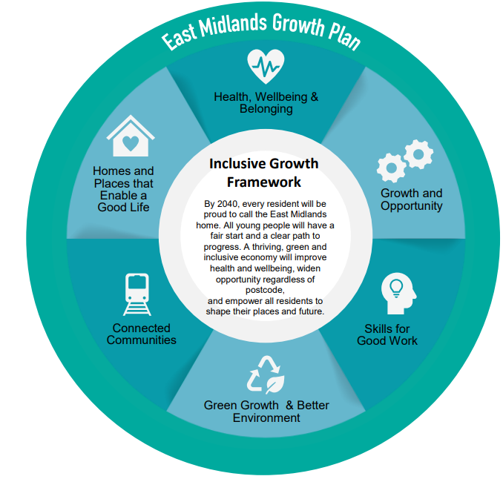
A Shared Vision Established
New regional story that’s optimistic and forward looking
Missions-based outlook to underpin regional working
A framework for interventions (delivery) detailed in the East Midlands Growth Plan
A clear theory of change focussed on enablers, high impact sectors, and place-based delivery
Apply the Opportunity Escalator to skills and employment systems
Notes:
So, we needed a strategy. What emerged?
The result of this work was a shared framework for inclusive growth. Six long-term missions around a central vision of the region by 2040.
The important thing was that the region had, for the first time, a common story about its future.
In the plan we aligned around the enablers of growth, the sectors where we could have the greatest impact, and a place-based model of delivery. In short, we had moved from a collection of priorities to a shared theory of change that then informed the policy and investment decisions we want to make.
____
Theory of change:
Invest in six enablers of inclusive growth.
Concentrate effort on high-impact sectors to drive productivity and wages.
Organise delivery through place-based Growth Strategy Areas.
Apply the Opportunity Escalator to skills and employment systems
Background steps:
Inclusive Growth Commission
Inclusive Growth Strategy
East Midlands Growth Plan
East Midlands Outcomes Framework

Slide 4
Why the Growth Plan Mattered
Write a strategy
Build a regional growth consensus
Reflection 1
Treat strategy development as coalition-building rather than document production.
Notes:
Now, colleagues, I want to shift from sharing the story of the work, to some of our reflections from doing so. I have 7, I will zip through.
The first is this. And most important.
It’s that strategy development should be treated, not as document production alone, but as coalition-building.
We didn’t want the classic glossy print that gathers dust on the shelf. But we also didn’t want a plan that didn’t have serious deliberation with partners, or making proper choices.
Creating this this became a vehicle for bringing people together around a shared vision, building relationships and trust, and creating consensus around shared priorities and action.
The strategy document mattered. But it was only one output.
Looking back, the more important outcome was those strengthened institutional and human relationships that emerged around it – and which it has been a core part of work not only to maintain, but to strenghten.

Slide 5
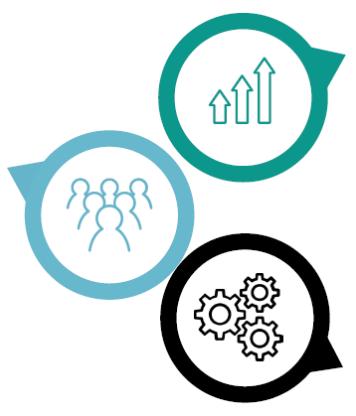
Creating Strategic Clarity
Reflection 2
Consensus is not everybody agreeing on everything. It is enough agreement to move together.
1. Growth Sectors
2. Enabling Investments
3. Places and Clusters
Notes:
We spent a lot of time trying to answer a deceptively simple question: what is the East Midlands growth story?
We knew it needed to be grounded in our actual places (histories, ambitions, assets), reflect our multi-centre (polycentric) economy, and connected to a positive + forward looking vision of the future.
The value of the process wasn't getting everybody to agree on everything. It was creating enough agreement around growth sectors, enabling investments and places to allow the region to move forward together.
For me, that's one of the most important lessons from strategy-making: consensus is not everybody agreeing on everything, it is having enough agreement to move together.
____
Visual shows links: (1) Growth Sectors > (2) Enabling Investments > (3) Places and Clusters
Speaking points:
• Early conversations revealed there was no simple answer to the question: what is the East Midlands economic story?
• The process helped align around a smaller number of strategic opportunities.
• Growth sectors became linked to enabling investments.
• Housing, skills, transport, innovation and net zero became delivery enablers.
• Increasing emphasis was put on spatial delivery through places and clusters, including examples such as the Trent Arc.

Slide 6






































Building the Coalition and Consensus
Reflection 3
Strategy making is fundamentally a collaborative and relational process.
Notes:
How then do we move forward together.
It has been so important in our region to establish an ethic, a way of working, through relationships.
A lot of what we were doing on this work, we were doing with partners for about the first time. Certainly in any real depth.
This is the 3rd reflection I would share, that strategy-making is a fundamentally collaborative and relational effort.
We (I) often talk about evidence, analysis and policy. All of those things matter.
But much of the real work involved building trust between institutions, creating shared understanding and developing confidence that we could act collectively as a region.
Looking back, the biggest outcome may not have been the strategy itself, but the strength of the relationships that emerged through the process.
Strategy-making, at its heart, is a social process.
____
Speaking points:
• The process built trust.
• It established shared language.
• It created mutual understanding.
• It increased confidence and ambition.
• The Inclusive Growth Commission helped create momentum.
• The work now continues through Team East Midlands and wider advocacy.

Slide 7
Ambition, Evidence and Deliverability
Ambition
Reflection 4
Shared visions survive when ambition is grounded in evidence and delivery credibility.
Evidence
Deliverability
Notes:
My fourth reflection is that ambition only endures when it is grounded in evidence and deliverability.
We found that many of the most important conversations – with partners and ourselves – were not about raising ambition, but about testing those ambitions. This is the work of challenging assumptions, understanding constraints, and building confidence that what we were proposing could actually be delivered.
The reflection here is: shared visions survive when ambition is grounded in evidence and delivery credibility.
____
Housing delivery case study:
• Ambitious aspirations existed from the outset.
• Detailed testing of assumptions was required.
• Evidence had to support ambition.
• Deliverability mattered.
• The result was a stretching but credible ambition.

Slide 8
From Ambitions to Delivery
Strategy. Shared Vision for Growth and Six Ambitions
Coalition. Building consensus, trust and regional ownership
Reflection 5
Growth Plans become powerful when they organise action, moving beyond only describing priorities.
Delivery. Missions, investment propositions and implementation
Platform. MSA can convene process and local, business and civic partners
Notes:
My fifth reflection is that strategy only matters when it changes behaviour.
Ambitions and visions are important, but they don't deliver outcomes on their own. The challenge is organising action.
For us in EMCCA, the shift was moving from describing priorities to creating ambitions, investment propositions and implementation approaches that could align partners around delivery.
Growth plans become powerful when they move on from describing action to organising it.
We all know that is a challenge when our public systems interact, and it needs an adaptation of mindset, outlook and behaviour. This is something that we’re learning to do in practice now.
____
Headline:
Speaking points:
• The six ambitions provide direction.
• Ambitions alone do not deliver change.
• The challenge is organising action.
• Missions provide a framework to connect policy, investment and delivery.
• They create accountability.
• They help partners align efforts around outcomes.
Reflection:
Growth plans become powerful when they organise action rather than simply describe priorities.

Slide 9
What We Underestimated
Reflection 6
Strategic agreement and delivery readiness are not the same thing.
From Shared Vision to Driving Impact
Investment Pipeline
Delivery Maturity
Institutional Capability
Notes:
My sixth reflection is that strategic agreement and delivery readiness are not the same thing.
We perhaps underestimated how much work remained after our plans were published. It look longer than we had anticipated to develop investment pipelines, strengthen delivery mechanisms and build institutional capability – all these things required more focussed attention than we initially expected.
So, here goes, we learn that publication of a long-term ambition shared vision for growth felt like a real milestone, but in reality it was the starting point.
The reflection, then, is perhaps to not confuse strategic agreement with delivery readiness.
___
Speaking points:
• Investment pipeline, which we initially (when established) expected to be more mature. Propositions have needed investment and development.
• Delivery maturity, as mechanisms have required strengthening, not just building up but also aligning and simplifying (eg DevCo integration or Freeport alignment).
• Institutional capability, as the organisation itself was still being build.
• Some of the hardest work happened after publication, on all these three fronts.

Slide 10
The Role of the MSA
Government & Agencies
Reflection 7
Mayors not just as reform or programme sponsors. The Mayor is the voice and convenor of a region.
Investors & Finance
Neighbouring Authorities
Mayor & EMCCA
Business & Trade
Local Govt Partners
Education & Skills
NHS & Public Services
VCSE & Community
Anchor Institutions
Notes:
Now the final reflection, on the role of the Mayoral Strategic Authority itself.
Going through this process reinforced for me that MSAs are more than delivery vehicles or funding bodies.
Their real value lies in their ability to convene. To bring together local government, business, education, public services, civic institutions and communities around shared priorities and collective action.
In that sense, the Mayor is not simply a programme sponsor. The Mayor is the voice and convenor of a region.
And perhaps that is the broader lesson from our experience: devolution is not simply about transferring powers. It is about building the institutions, relationships and confidence that allow a place to shape its own future.
If I had to reduce all of that to three lessons, they would be: build a coalition, not a document; link strategy to delivery from day one; and treat the MSA as a platform for regional action.
[The most important thing we produced was not the Growth Plan itself. It was a stronger East Midlands capable of acting together.
The task of devolution is not simply transferring powers. It is building the institutions, relationships and confidence that allow a place to shape its own future. ]
Thank you."
____
Headline:
MSAs are more than delivery vehicles. They and the institutions they lead must be an organising force of their regional system.
Speaking points:
• We are through a shift that sees MSAs as funding bodies, to strategic system leaders. They convene partners.
• It provides democratic legitimacy.
• It represents regional interests nationally.
• It helps create alignment across public, private and civic sectors.

