Slide 1
Increasing the supply of affordable homes in the West of England
Stephen Peacock
Chief Executive Officer
West of England Combined Authority
25th February 2026

Slide 2
The affordable homes challenge: context in the West of England
Housing affordability and availability
  Housing costs around 9 times annual median earnings, well above the England average of 7.7 times median earnings.
  50,000 households on the waiting list for social housing.
  Bristol’s average rent 45% of median income. B&NES average rent 43% median income. The two highest % outside London.
Quality of life is impacted by poor housing
  66,000 of homes in the region do not meet the decent homes standard.
  2,000 children living in temporary accommodation.

Slide 3
The affordable homes challenge: context in the West of England
Viability is a major constraint for our urban sites
  Bristol is the 8th most expensive city in the world to construct new buildings; 2nd most expensive in the UK after London.
  High costs of infrastructure and brownfield site remediation limit financial viability of urban delivery.
  In many parts of Bristol and Bath purpose-built student accommodation is the only form of development that is currently market attractive and deliverable without subsidy.
Brownfield constraints
Bristol, as with all UK cities, is low density compared to European and other international cites.
Balance between density and commercial viability to make optimum use of finite brownfield sites.
Skills shortages
A lack of skills/workforce supply constrains ability to meet demand, particularly for retrofit and construction

Slide 4
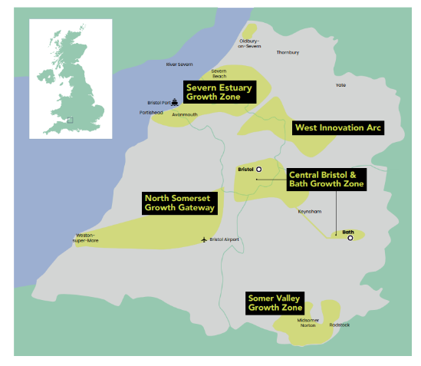
MCA action to increase the supply of affordable homes
Regional Growth Strategy: growth zones
Emphasis on key growth locations so that infrastructure delivery can be focused, effort is joined up and draws on best practice placemaking:
Bristol and Bath – focus on city centres, Bristol Temple Quarter, Bath Riverside and Quays North and strategic corridor
West Innovation Arc – Brabazon, regeneration and new neighbourhoods
Somer Valley – housing allocations to compliment rural towns and settlements
North Somerset – development at Weston and well-connected towns

Slide 5
MCA action to increase the supply of affordable homes
Spatial Development (SDS) will set the spatial framework for the region and determine where new housing sites will be allocated
Mass transit routes identified within an integrated network joining to rail, bus and active travel:
  Bristol to Bath corridor and city centres
  Bristol centre to Brabazon and the West Innovation Arc
  Radial route through Bristol East fringe
  Bristol to Airport and onwards to Weston
Planning for homes at strategic locations along these routes and at major centres and hubs aligned with the SDS

Slide 6
MCA action to increase the supply of affordable homes
Strategic Place Partnership (SPP) with Homes England
The SPP sets out four strands of our place-based approach:
Pipeline – developing a robust pipeline of investment-ready proposals
Transformational place-based growth – focussed and bespoke intervention on regional priority areas
Housing supply – improving the supply of high-quality, energy efficiency, climate resilient and affordable homes
Strategic intervention – leverage additional public and private sector investment to deliver homes the region needs.
Historically, the MCA has taken action on a project basis to increase supply of affordable homes
Bath Riverside, Hengrove Park

Slide 7
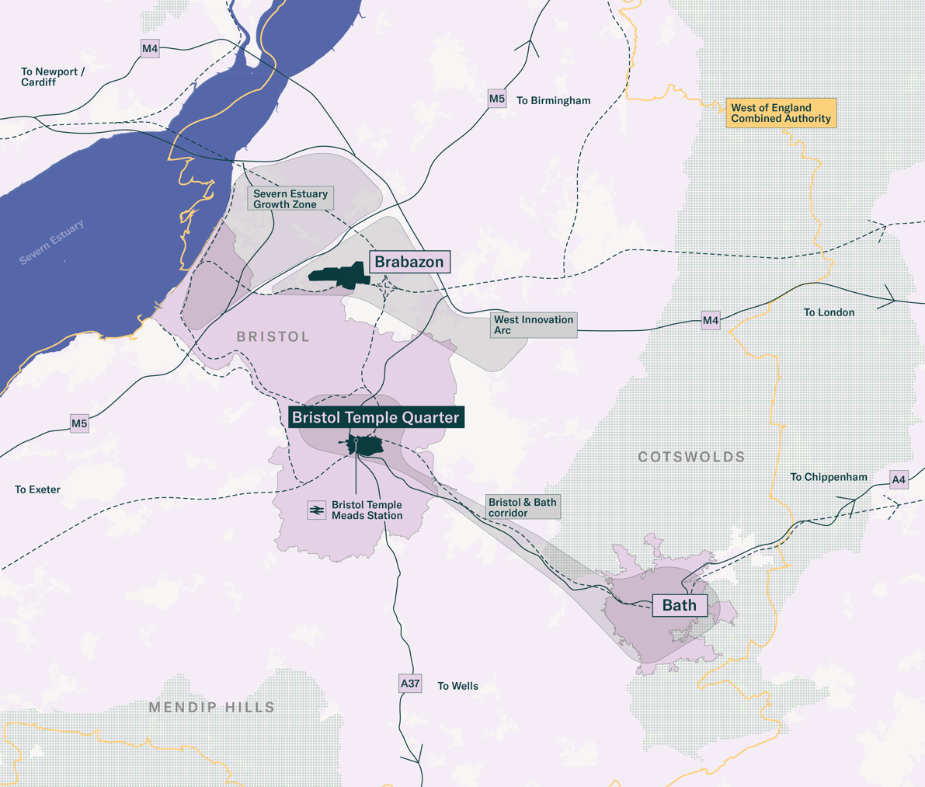
Case study: Bristol Temple Quarter
Delivering affordable homes in Bristol
Bristol Temple Quarter will deliver over 10,000 homes over the next 20+ years
£95m from Homes England to unlock Phase 1 Temple Meads West
BTQ will play a key role in improving lives in the immediate locality, focusing on those in the some of the 10% most deprived areas of the country
Will deliver 5% increase in regional GVA; new University of Bristol Campus and innovation district.
Fundamental plank of the West of England Growth Strategy, linking the West Innovation Arc, Central Bristol growth zone and Bath.

Slide 8
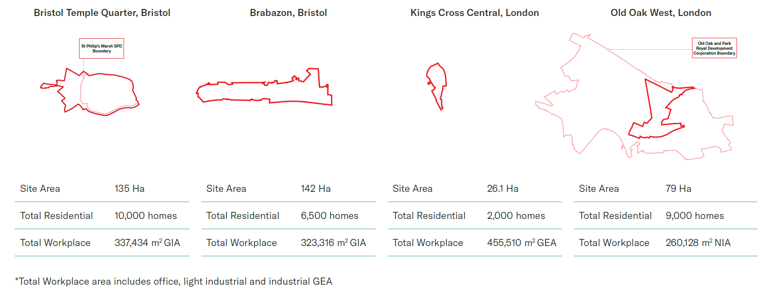
Case study: Bristol Temple Quarter
Delivering affordable homes in Bristol

Slide 9
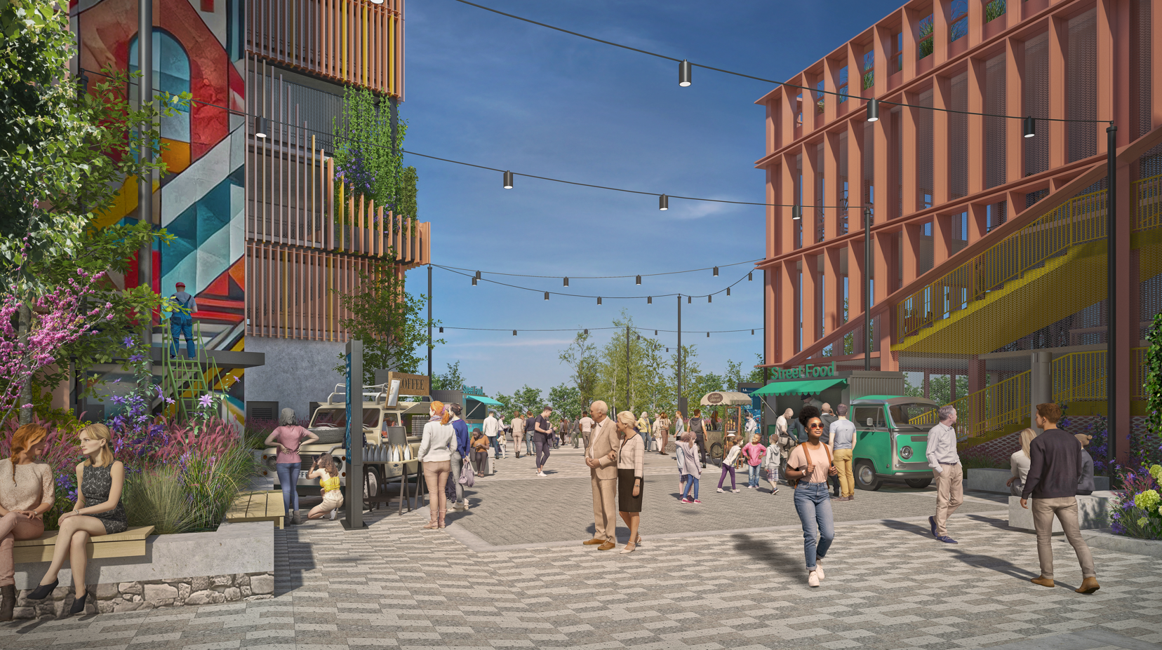
Progress to date
Case study: Bristol Temple Quarter
LLP established
Private sector partner appointed
Masterplans in development for Phase 1 Temple Meads West and St Philips Marsh
Southern Gateway designed as multi-modal transport hub, construction to commence summer 2026
Temple Quarter Enterprise Campus (Bristol University) opening later this year
Community Fund and Hub launched

Slide 10
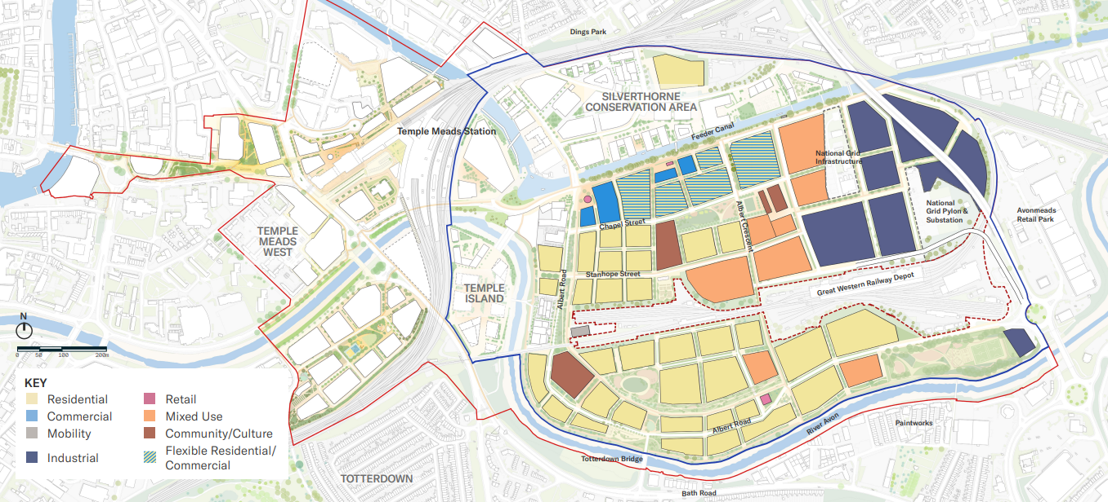
St Philip’s Marsh masterplanning
Case study: Bristol Temple Quarter
Illustrative land use map for St Philip’s Marsh.

Slide 11
Main challenges
Case study: Bristol Temple Quarter
Viability relies on the right use of tenure
Many developers currently unable to deliver policy compliant numbers of affordable homes. Focus currently from the private sector is on purpose-built student accommodation.
Planning
BTQ LLP preparing a Supplementary Planning Document (SPD) to accompany the Local Plan.
Enabling infrastructure required
Utilities, energy, flood mitigation, access over/around the waterways and railway infrastructure, primary care, schools, redesigned roadways and greenspace.
Future Places Fund
Land assembly and preparation, including in St Philip’s Marsh, to facilitate comprehensive regeneration. Timely intervention will support coordinated development and maximise economic growth potential.

Slide 12
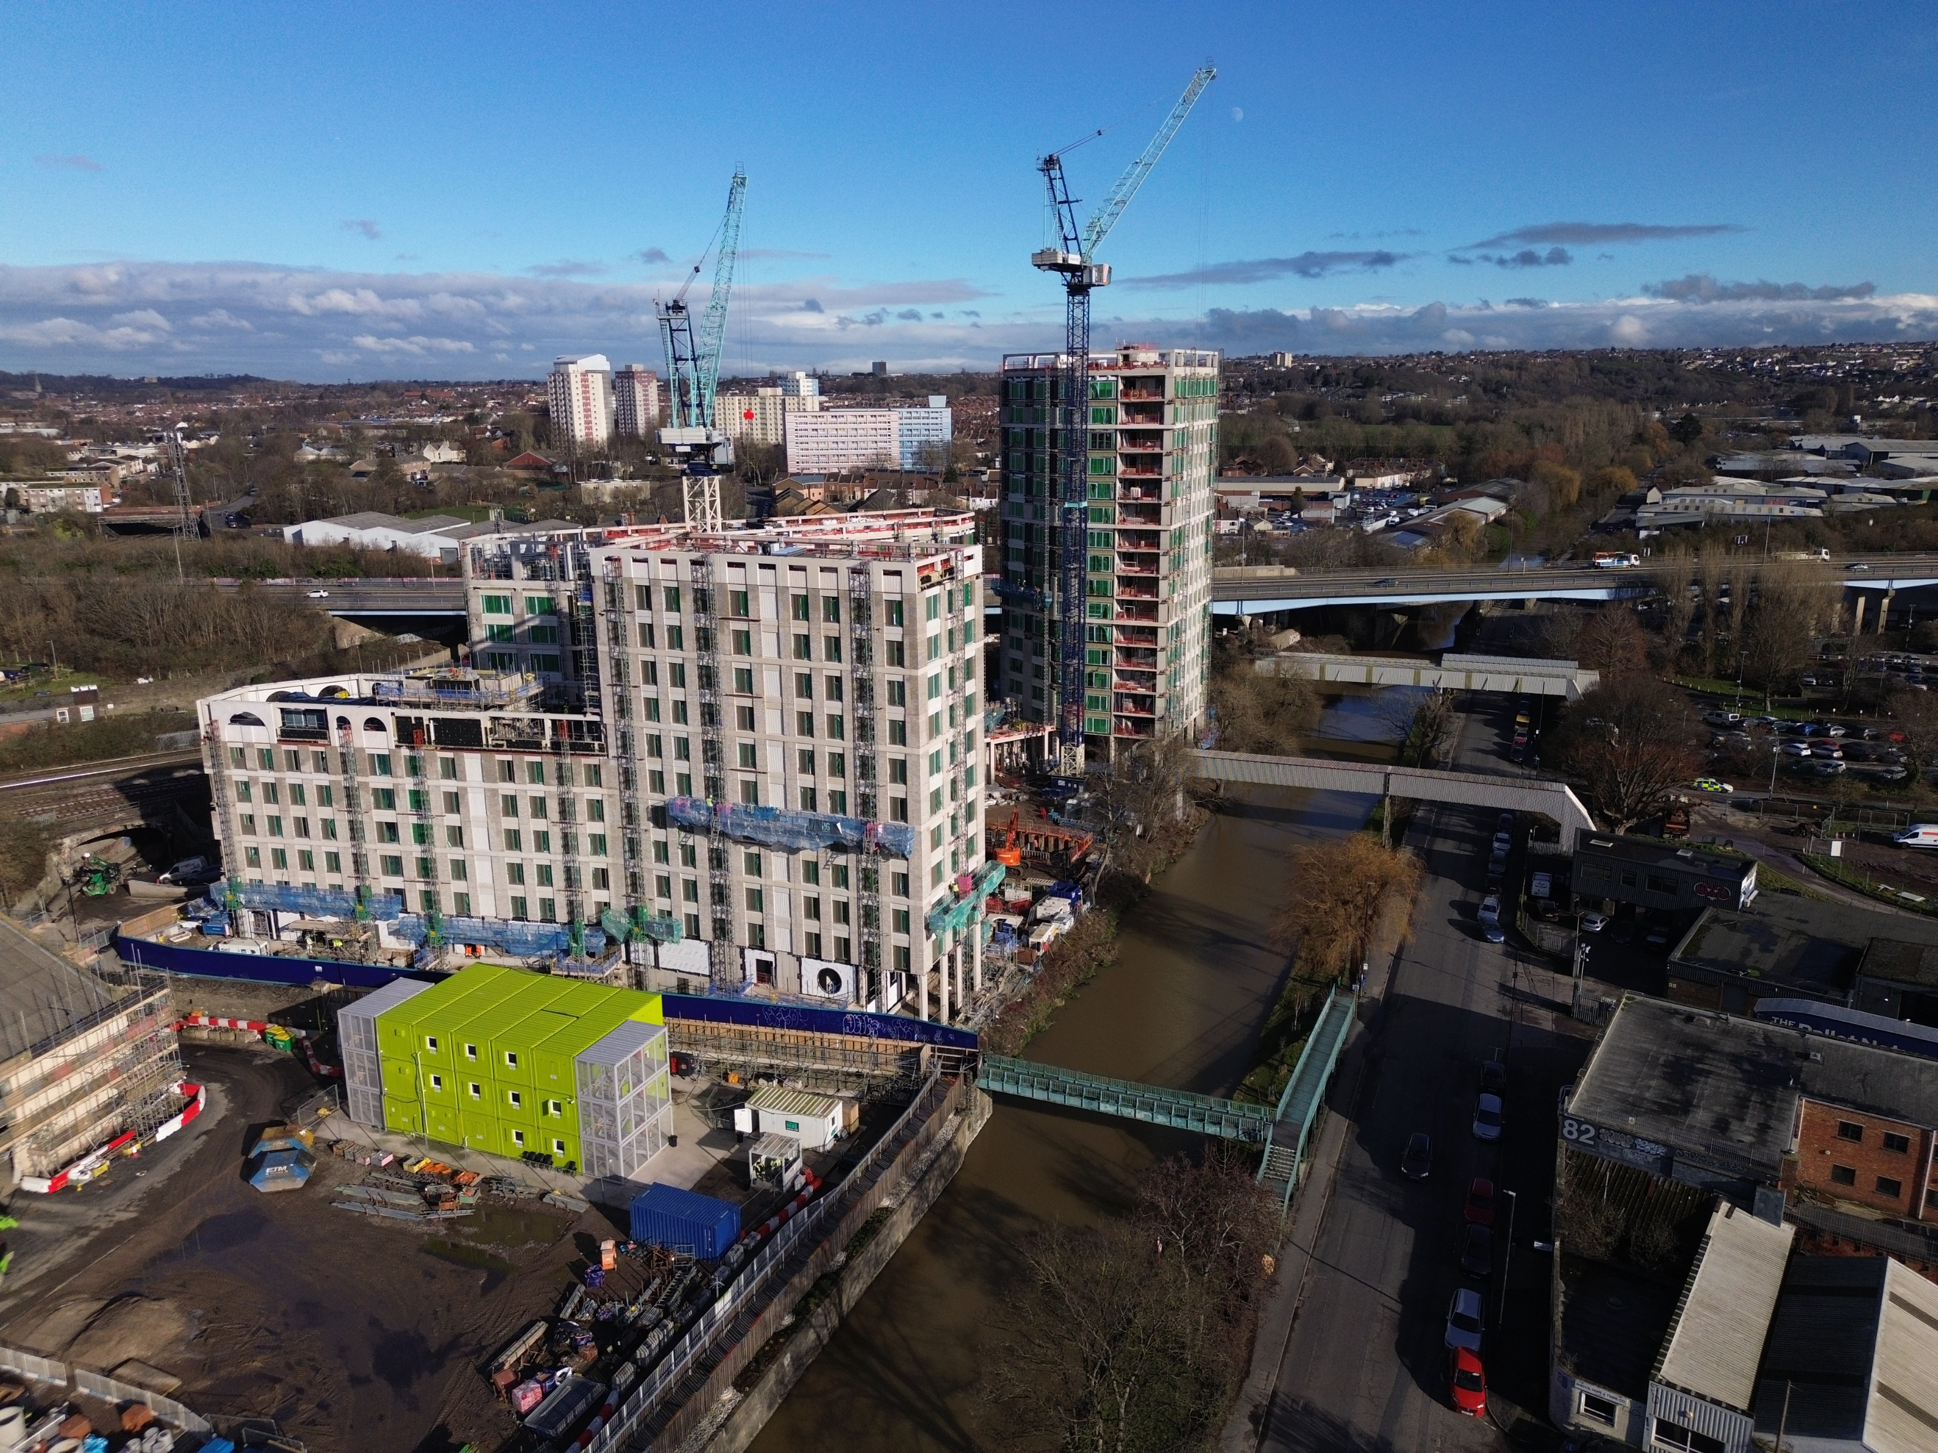
Lessons learnt
Case study: Bristol Temple Quarter
Strong local and regional political buy-in and leadership
Ongoing funding/finance to deliver enabling infrastructure that then unlocks regeneration
Comprehensive master-planning to enable coordinated delivery at scale
Land assembly to accelerate delivery and prevent value leakage
Delivery models and governance arrangements (LLP / Mayoral Development Corporations etc.)
Collaboration and partnership
Fostering innovation with private sector partners

Slide 13




Meeting the challenges of affordable homes delivery
Partnership working is key; Mayors are uniquely placed.
Good governance to enable effective decision-making and strengthen investor confidence.
Further devolution to unlock the full potential of affordable housing delivery.
Long term integrated planning with housing priorities embedded within regional economic growth strategies.

