Slide 1
Supporting regions to increase the supply of affordable homes
Jackie Rigby, Assistant Director, Regeneration, Partnerships and Major Projects

Slide 2
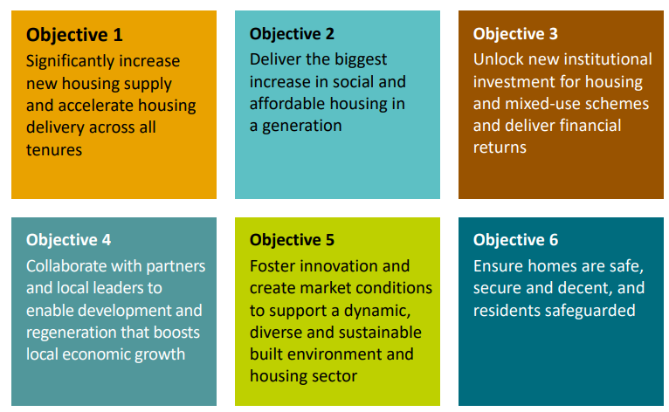
Our strategic objectives
Our newly published 2025-30 Strategic Plan sets out six interconnected strategic objectives that work together to support the delivery of the government’s housing, regeneration and economic growth priorities.
To deliver Objective 2, our strategic plan recognises that we will work in partnership with Mayors and Local Authorities to draw from our suite of powers and resources to meet local housing need and economic growth ambitions.

Slide 3
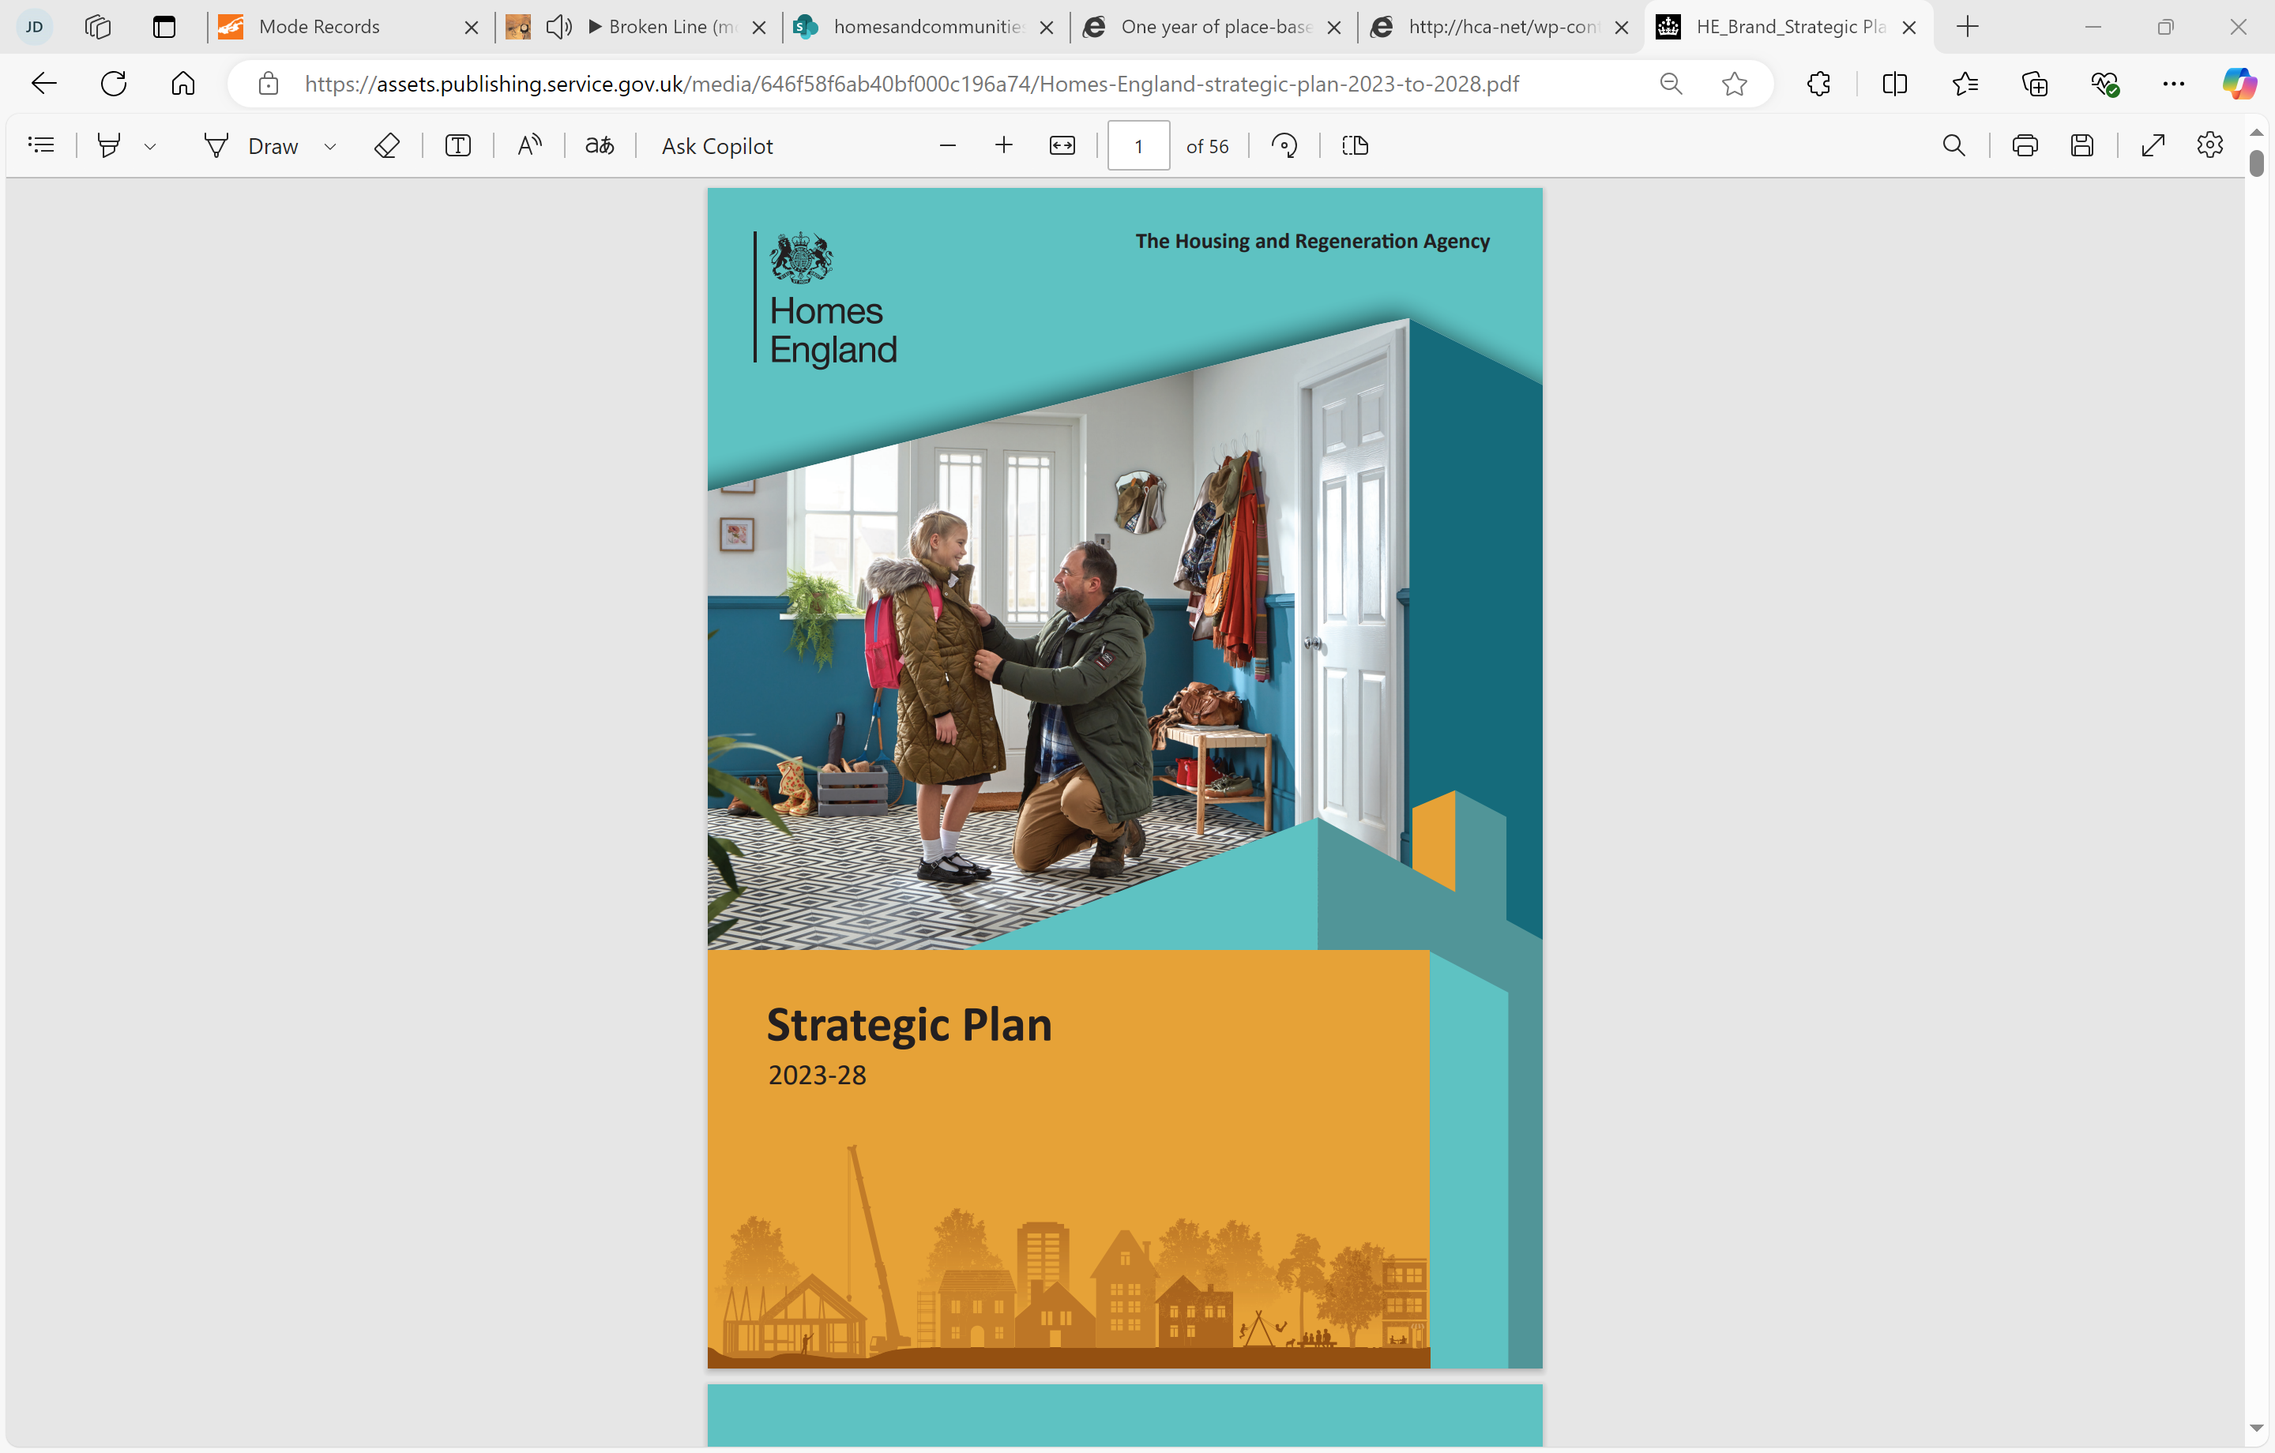
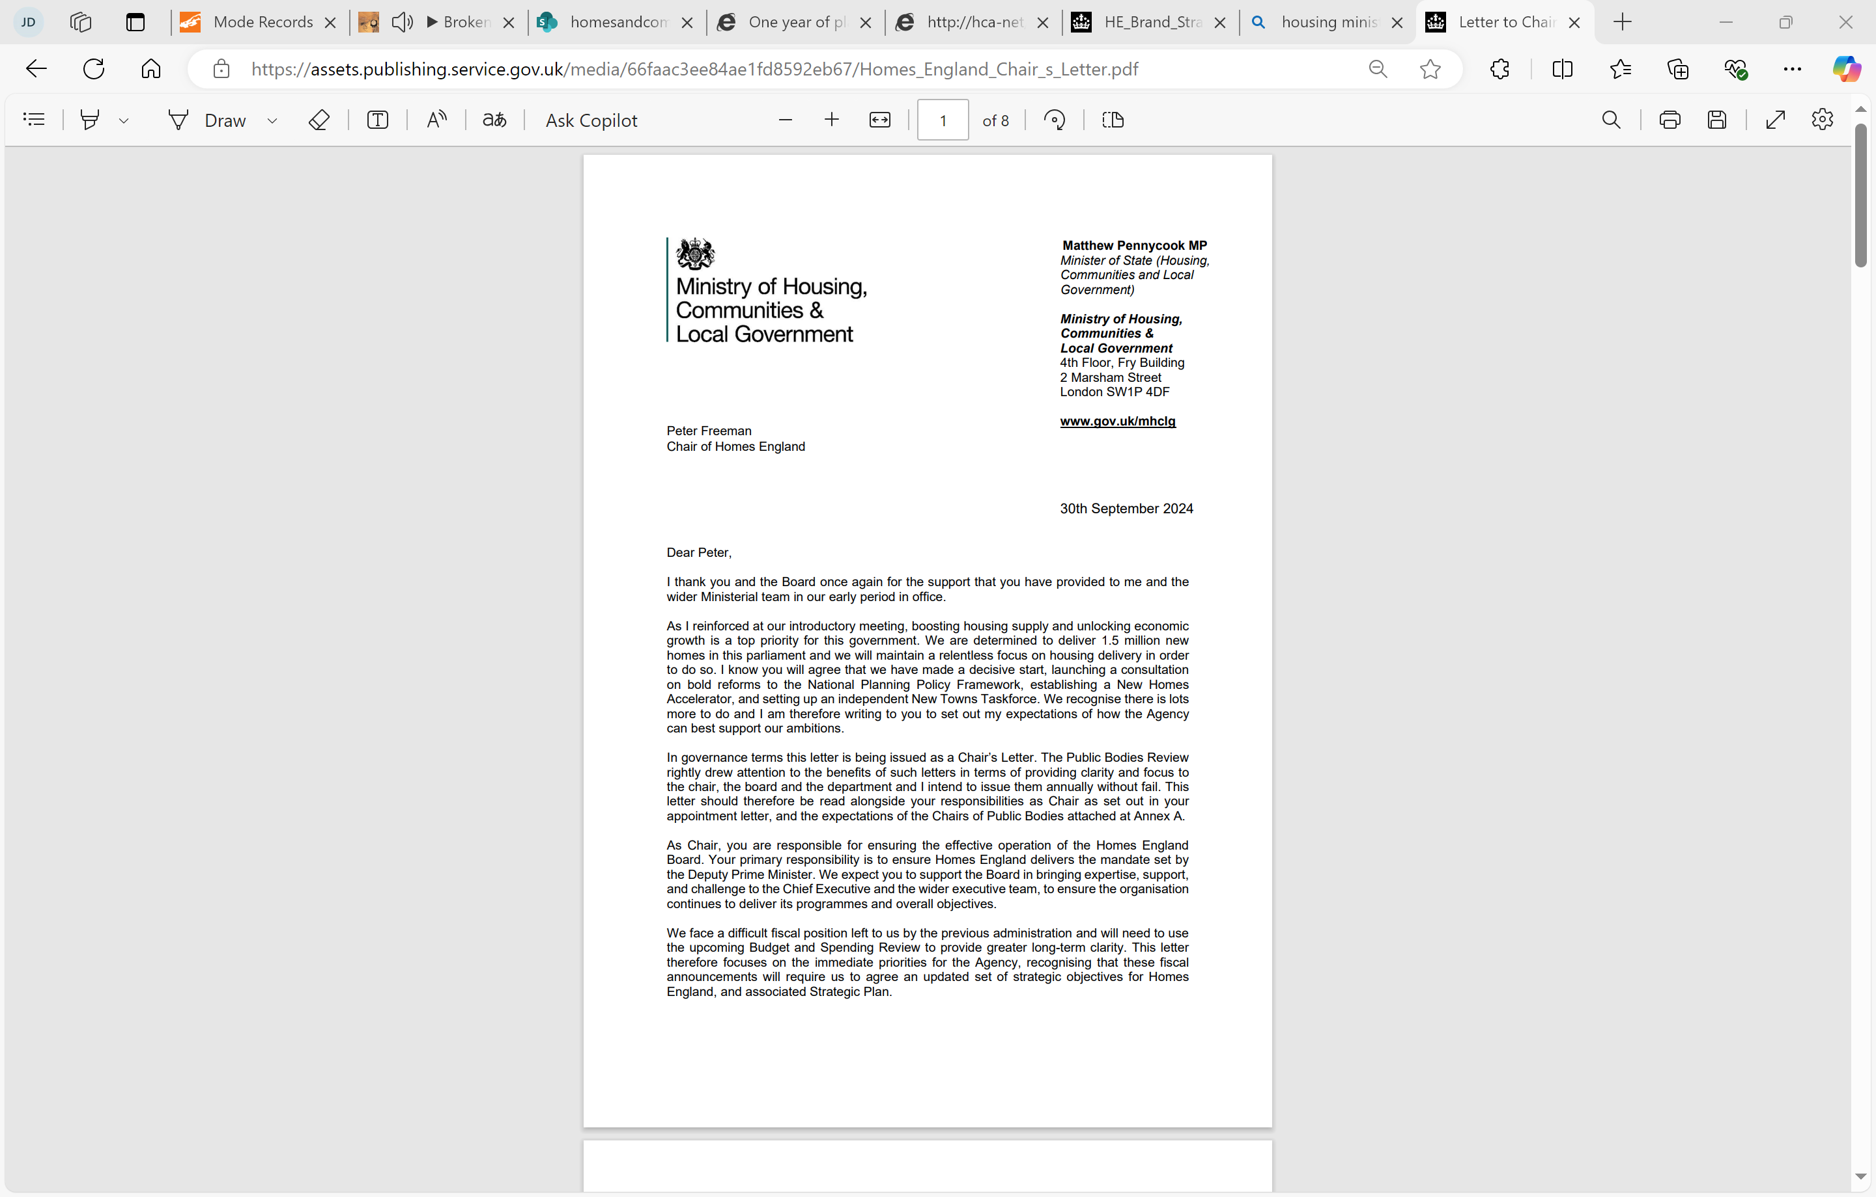
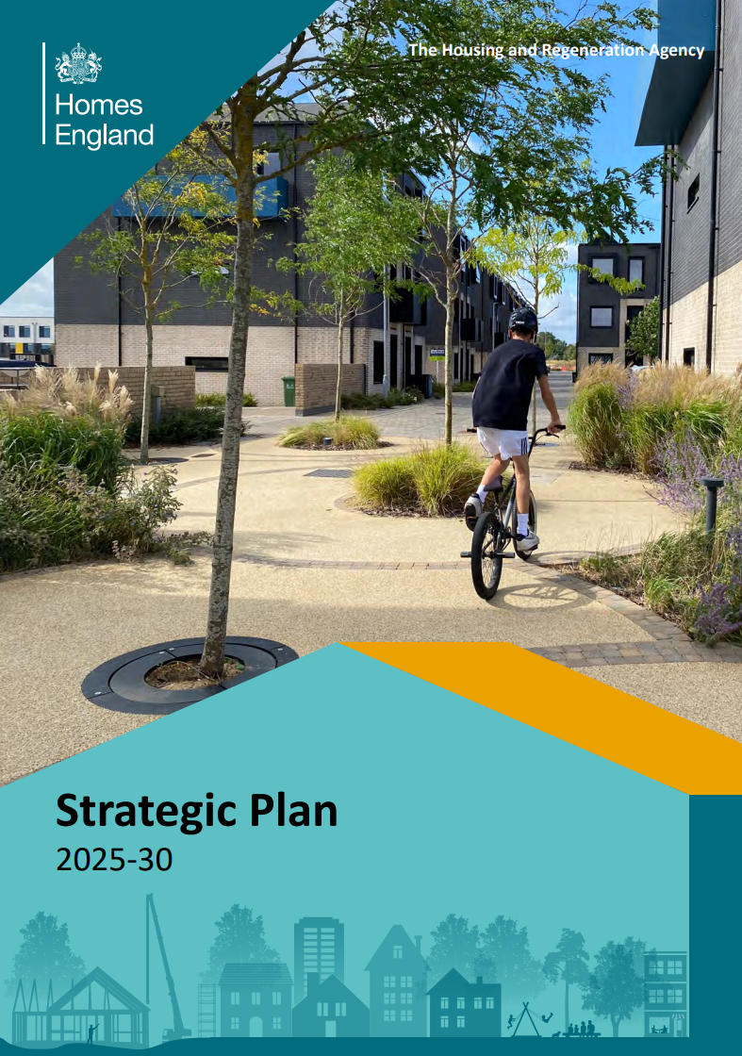
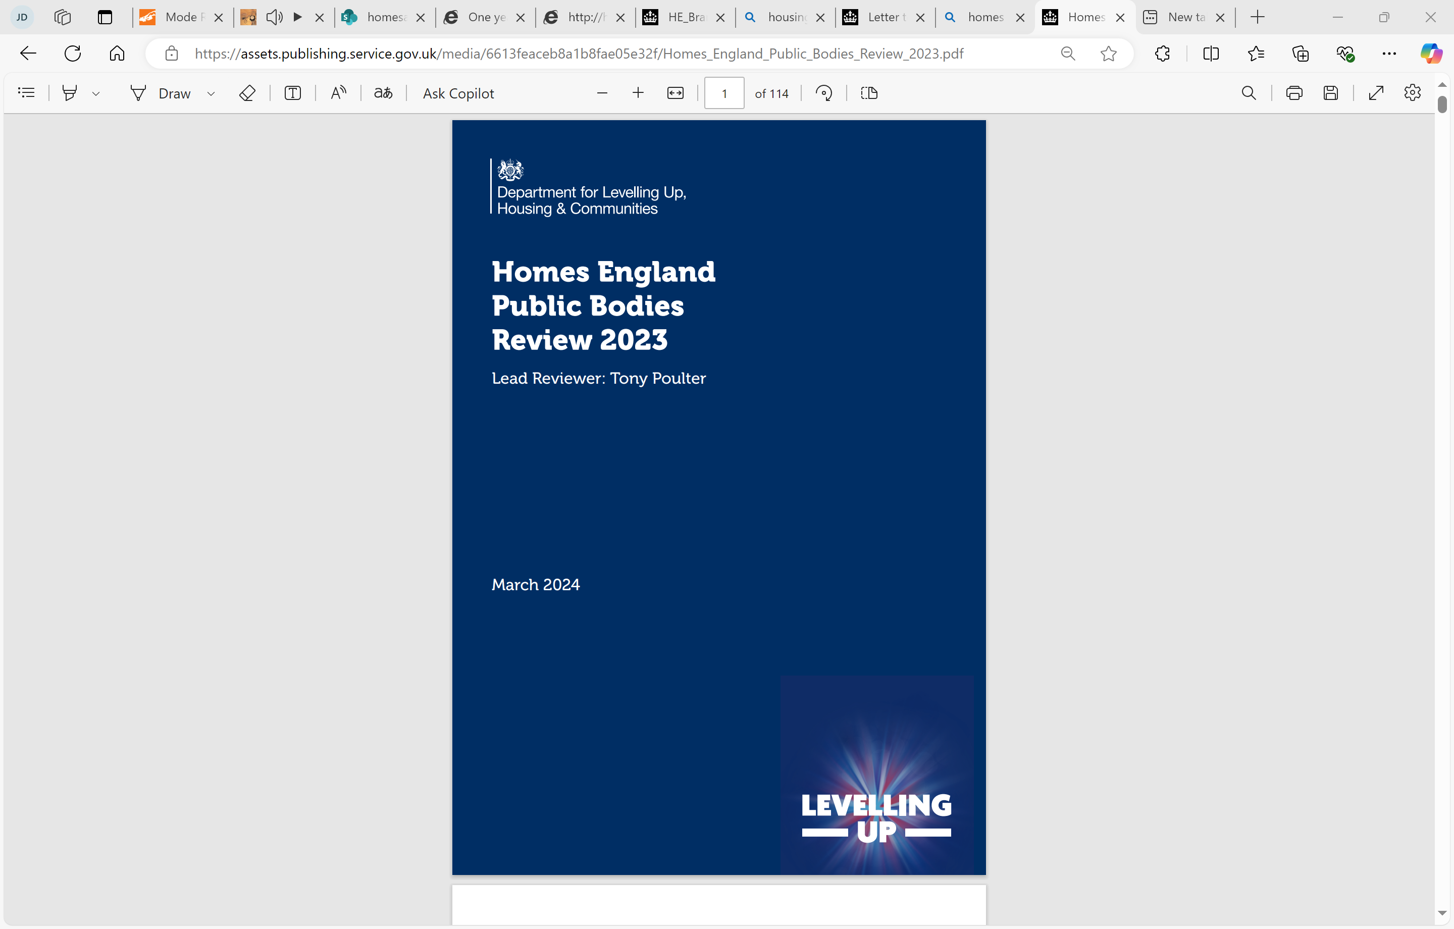

Place-based working
Over the past 3 years, Homes England has increasingly concentrated its most intensive efforts in supporting local leaders’ ambitions by taking a place-based, regional approach to delivery.
2025-30 Strategic Plan
(December 2025)
“We are changing how we operate to ensure that we are best-placed to support all of our partners as effectively as possible. This means that, alongside our commitment to national expertise and the creation of a specialist National Housing Bank, we are significantly strengthening our regional teams”
2023-28 Strategic Plan (May 2023)
“We will make place-based working central to how we operate”
Chair’s letter (September 2024)
“[Your priorities] should include the rapid implementation of a … sustainable, regional and place-based operating model to reflect the shifting focus to delivering successful placemaking and align with our wider devolution agenda”.
May 2023
Sept 2024
Dec 2025
March 2024
Dec 2024
Public Bodies Review (March 2024)
“[Homes England should] develop its operating model to focus its work as much on places as on national funding programmes”.
Devolution White Paper (December 2024)
“Homes England will move to a more regional and place-based operating model to align its structures and ways of working to the government’s devolution agenda”.

Slide 4










Delivering in partnership
Partnership working is central to our regional approach, creating a framework for a shared commitment to local priorities. Our flagship model, the Strategic Place Partnership (SPP), enables joint alignment with Mayoral Strategic Authorities on their housing and regeneration ambitions by bringing together each partner’s strengths and resources.
The aims of a strategic place partnership are to:
Clearly agree and articulate a shared ambition and set of shared strategic outcomes.
Create a coordinated approach to unlocking these ambitions – including working across different government departments.
Explore and share intelligence and jointly prepare and prioritise a pipeline of opportunities.
Use the leverage of the partnership to better target and align public and private sector resources, skills and expertise.
Learn and share knowledge to strengthen delivery capacity.
To date, the Agency has ten SPPs in Place across the country.

Slide 5
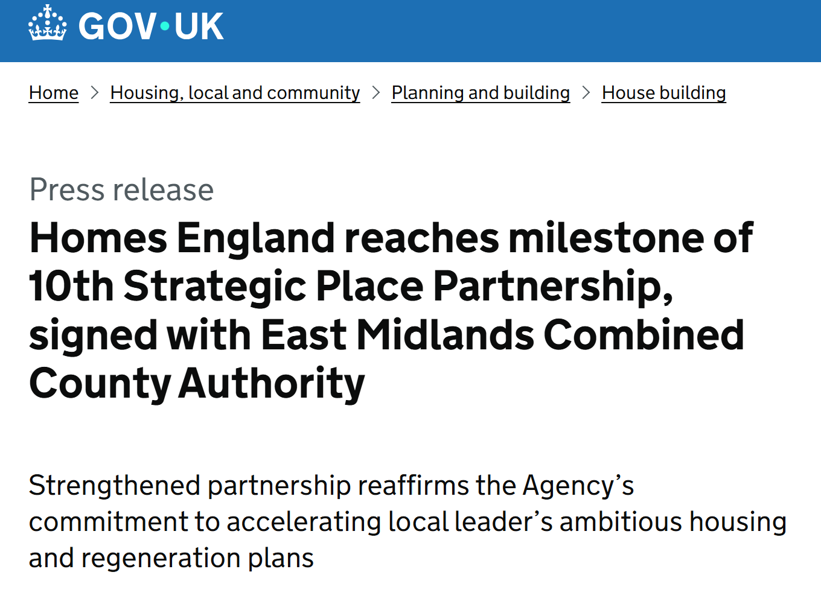
Recent successes
Each of our ten existing SPPs include a strategic objective focussed on the delivery of affordable housing, supported by a partnership business plan detailing the activities and workstreams required to achieve it.
Recent successes against these objectives includes:
Jointly progressing a range of affordable housing interventions in South Yorkshire including £12 million grant allocations to affordable housing sites in Sheffield, alongside funding a Council Housebuilding Commission to enhance direct delivery of council housing across the four stock holding local authorities
Co-investment with the West Midlands Combined Authority since March 2024 to unlock around 3,000 new homes in the region, of which nearly 2,000 are affordable
Establishing new ways of working to co-ordinate the delivery of the Affordable Homes Programme 2021 – 2026 to enable Greater Manchester to prioritise projects in their Brownfield Housing Fund pipeline

Slide 6



Social and Affordable Homes Programme
The new Social and Affordable Homes Programme (SAHP) is the largest investment in social and affordable housing in a generation and will help contribute to the government’s commitment to delivering 1.5 million homes this parliament.
The Government has confirmed the role that Established Mayoral Strategic Authorities (EMSAs) can play in their areas to ensure that decisions on affordable housing meaningfully recognise and respond to Mayoral ambitions.
This includes:
    Setting the strategic direction of the programme in their areas through the publication of their priorities as part of the funding guidance and incorporating these within bid assessment criteria
    Receiving an indicative funding envelope indicating the minimum level of SAHP funding that is likely, but not guaranteed, to be allocated in their areas
Building on our existing SPPs, we are enhancing our approach and introducing new ways of working to ensure that decisions on affordable housing directly align with local priorities and to provide Mayors with greater ability to steer and monitor activity in their areas.

Slide 7



Regionalising our approach
Our transition to a five-region operating model will strengthen our understanding of local priorities, enhance how we work with partners, and allow us to tailor our support more effectively than ever before. Working alongside our regional teams, a national Technical Capacity and Coordination Hub, alongside the National Housing Bank will help the Agency to act more quickly and provide bespoke support for partners and places.
Regional Teams
Our regional teams will be led by new Regional Executive Directors, allowing us to work even more closely with Mayors and local leaders
These teams will bring together colleagues with expertise in business and proposition development; land acquisition, disposal and master development; alongside social and affordable housing strategy and pipeline development. This integrated approach will enable us to respond more effectively to the specific housing and regeneration priorities of our partners.
Technical Capacity and
Coordination Hub
Our regional teams will work hand-in-hand with a nationally managed hub which will provide specialist expertise that can be deployed flexibly throughout the development process, helping to boost delivery across the five regions
National Housing Bank
The National Housing Bank will be fully integrated within the wider Agency, ensuring it works seamlessly with our regional and national teams to provide integrated packages of support to places.
Alongside other types of funding, this will include the ability to provide low-interest loans to Private Registered Providers to support the delivery of more social and affordable homes.
Our Strategic Place Partnership model will continue to be the primary route for bringing together all of the Agency’s tools and expertise to align with local priorities and our shared partnership objectives.

